Slide 1
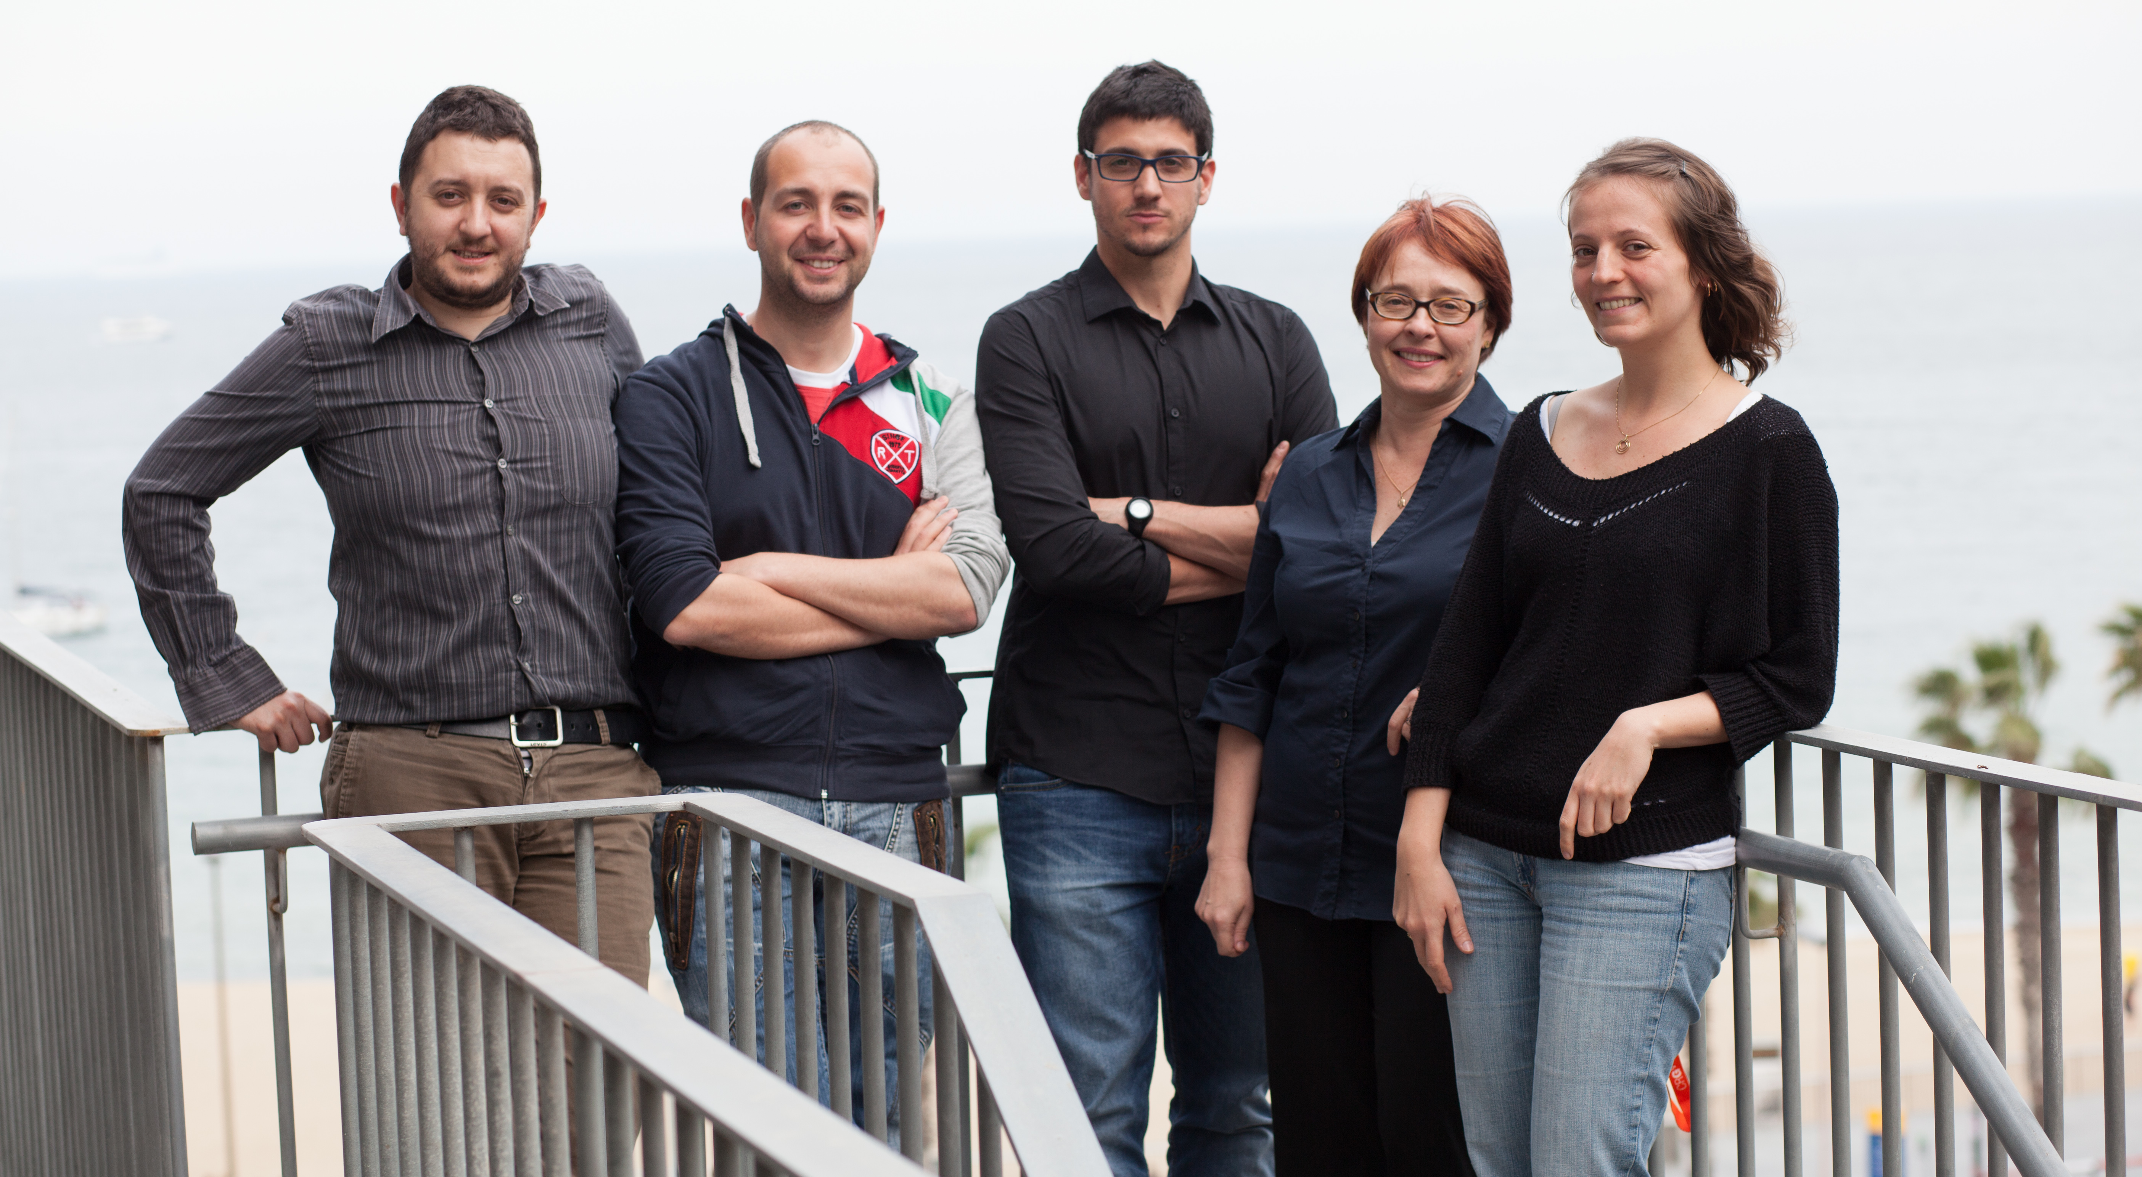
CRG Bioinformatics Core:
Jan - Dec 2015

Slide 2
Focus of the core
Bioinformatics services provided in 2015 →
  17 CRG PIs (not including administration) and
  13 external PIs.

Slide 3
Focus of the core (cont.)
CRG level and collaborative research projects →
  Saca La Lengua project (Luis Serrano & Toni Gabaldon) – awards, press
  Opitz-C syndrome project (Luis Serrano & UB)
  MyMpn (database on Mycoplasma pneumonia) (Luis Serrano)
  VastDB (Manuel Irimia)
  RNA-protein aggregation (Gian Tartaglia & Anja Schneider, German Center for Neurodegenerative Diseases, DZNE Goettingen)
  microbiome of Down syndrome mouse model (Maria del Mar Dierssen & Bartek Wilczynski, University of Warsaw)
  16S rRNA sequencing and analysis benchmark (CRG Genomics core)
  Lung tissue microbiome of COPD patients (Alvar Agusti, Hospital Clinic)
  Metagenomics of COPD patients (4 Barcelona hospitals)
  LIBRA project (PI Isabel Vernes)
  Infrastructure for internal data integration, analysis, and management (Luis’s Mycoplasma Big project as a starter) → a database developer was hired to start in Jan 2016.

Slide 4
Focus of the core (cont.)
Implementing new technologies and developing new expertise
  Microbiome 16S rRNA analysis: set up three pipelines (CHIIME, mothur, Ribopicker), benchmarked on the MOCK communities sequencing data; metagenomics.biocore. crg.eu (resourcs, papers, protocols, software).
  SNV calling from human whole-genome sequencing data
  CNV calling from WG seq data??
  iCLIP-seq analysis ???
  Single-cell RNA-seq
  TAIL-seq analysis pipeline (Fátima Gebauer)
  Ig-seq of B- & T-cell receptors repertoire (looking for the coordinator)
  ??????

Slide 5
Focus of the core (cont.)
Cataloguing “know-how” expertise and community involvement →
  Bioinformatics Technical Club (PRRB/CNAG) → SOPs: bc.biocore.crg.es, 39 members, 4 mtgs in last 2 months
  Bioinfo-core.org → participated in the ISMB mtg and quaterly-based teleconferences
  Core4Life alliance → Bioinformatics WG for expertise and know-how exchange
  CRG software catalogue → administrative mtg on Oct 21:
    Will use http://software.crg.es
    Design web form for software submission by PIs
    IT will provide the list of servers by PIs
    BioCore will work with PIs on software submission and catalogue maintenance

Slide 6
Focus of the core (cont.)
Training/Teaching →
  Wiki-How short course at the CompBio retreat (May’15)
  CRG Master/PhD course Intro to Bioinformatics (Oct’15)
  Will host a PhD student intern from South Africa (Novartis-CRG mobility program) Jan-June 2016 (penile microbiome analysis of HIV/HPV infected couples)
  Will host a PhD student from Argentina Jan-Mar 2016 (genome assembly and SNV analysis of P. aeruginosa strains)
  Internal course on how to use Genome Browsers
  CRG Bioinformatics external course (focus, audience ???)

Slide 7
Questions to the committee
We/CRG need 1TB (better 2TB) compute nodes!
Increase travel budget for attending really nice courses
PIs’ support with the Bioinformatics Club.
Which services PIs would be interested to outsource (rather than software maintenance)?
What new technologies and services are anticipated?

