Slide 1
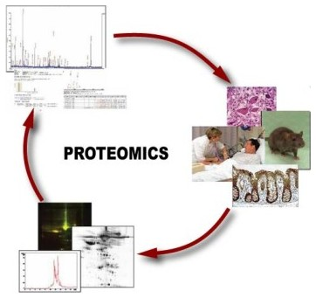
A basic overview of Proteomics
Bioinformatics Unit Lab Meeting
F.M. Mancuso
21/02/2012

Slide 2
The proteome is defined as the set of all expressed proteins in a cell, tissue or organism (Wilkins et al., 1997).
Proteomics can be defined as the systematic analysis of proteins for their identity, quantity and function.
Why proteomics?
Protein alterations cannot be fully deduced from DNA.
RNA expression does not always reflect protein levels (i.e. translational control, degradation, turnover,…)
Some tissues not suitable for RNA expression analysis.
Proteins are the physiological/pathological active key players.
General goal:
better understanding of genesis and progression of diseases
Clinical goals:
early disease detection (biomarkers)
identification of therapeutic targets
therapy monitoring

Slide 3
Applications of Proteomics
Mining: identification of proteins (catalog the proteins)
Quantitative proteomics: defining the relative or absolute amount of a protein
Protein-expression profile: identification of proteins in a particular state of the organism
Protein-network mapping: protein interactions in living systems
Mapping of protein modifications: how and where proteins are modified.

Slide 4
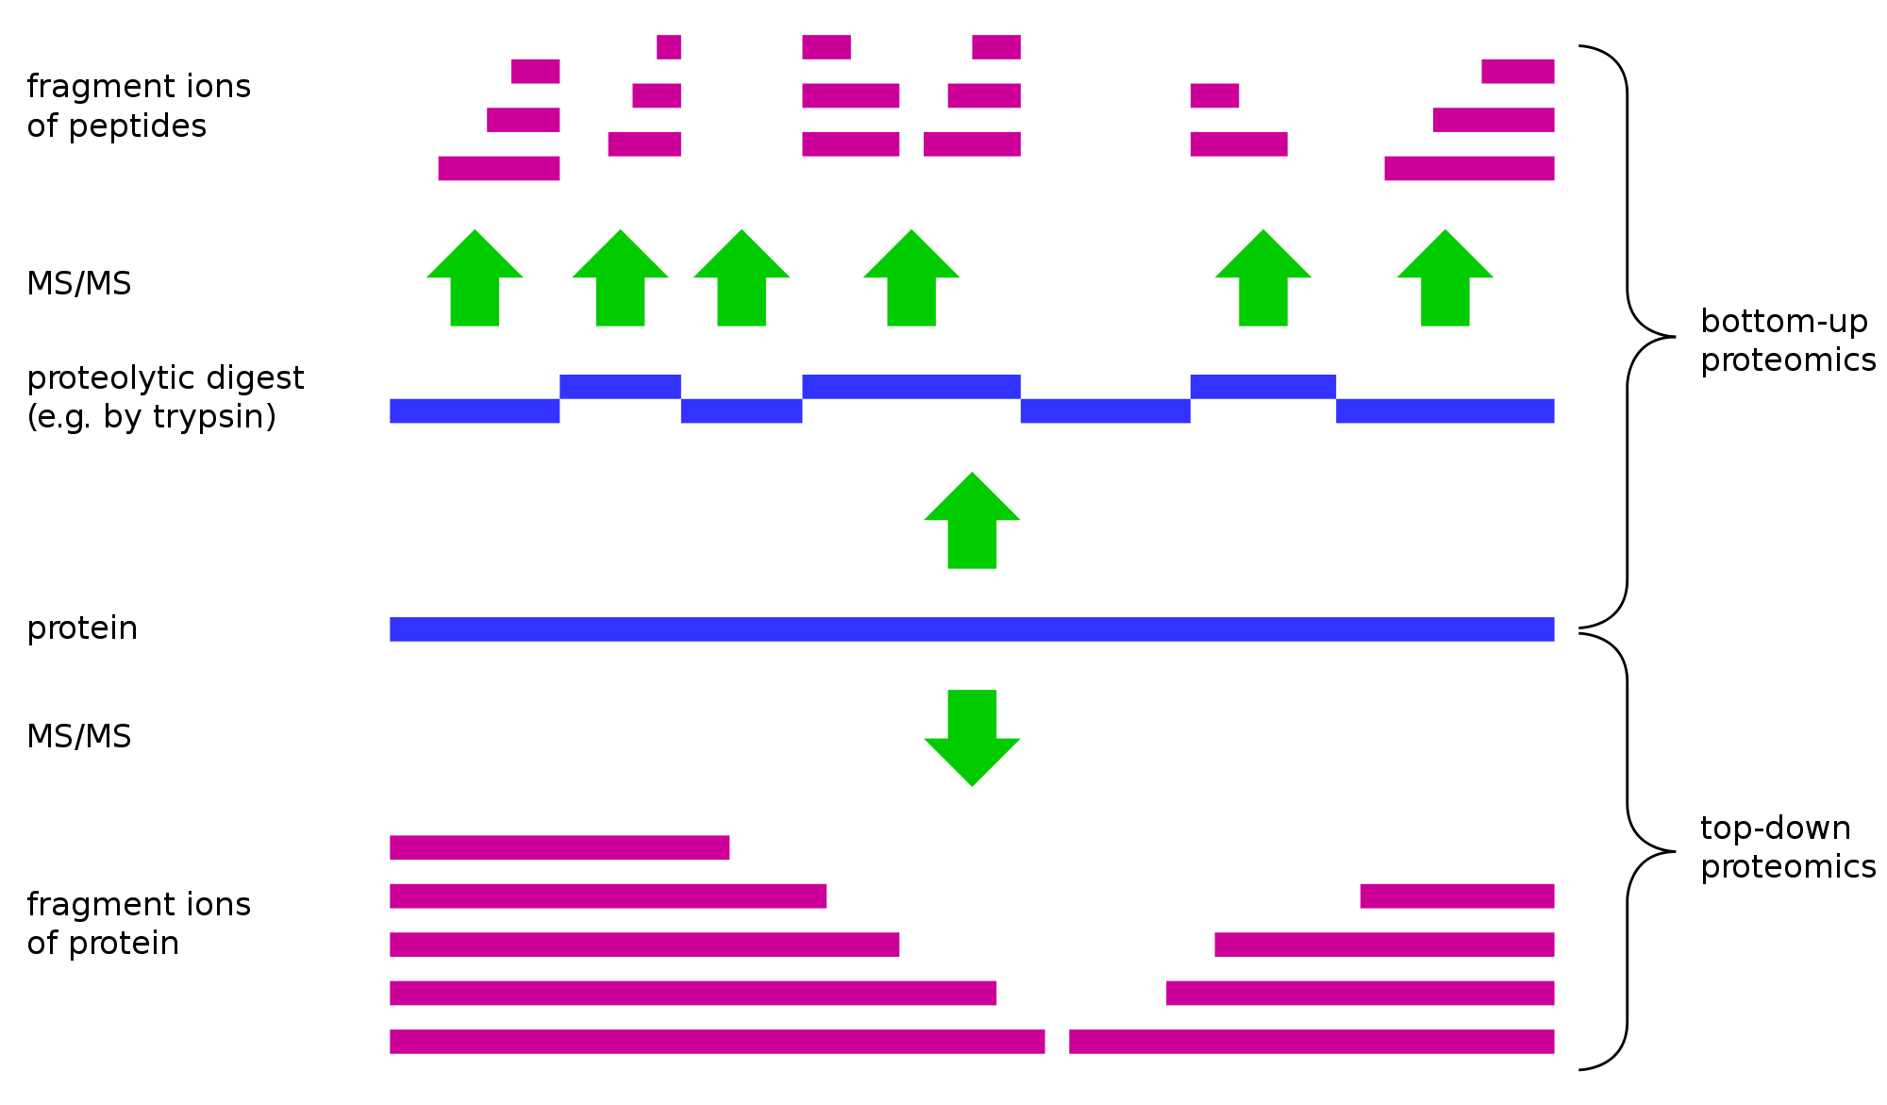
Top down or bottom up?
Bottom-up
Most common
Starting with proteolytic fragments
Piecing the protein back together
de novo repeat detection
Top down
Tandem MS of whole protein ions
Pulling them apart
Electron capture dissociation
Extensive sequence information
Fragment ions of peptides
MS/MS
Bottom-up
Proteolytic digest
e.g. Trypsin
Protein
MS/MS
Top down
Fragment ions of protein
”Protein mass spectrometry" Wikipedia, The Free Encyclopedia. Wikimedia Foundation, Inc.

Slide 5
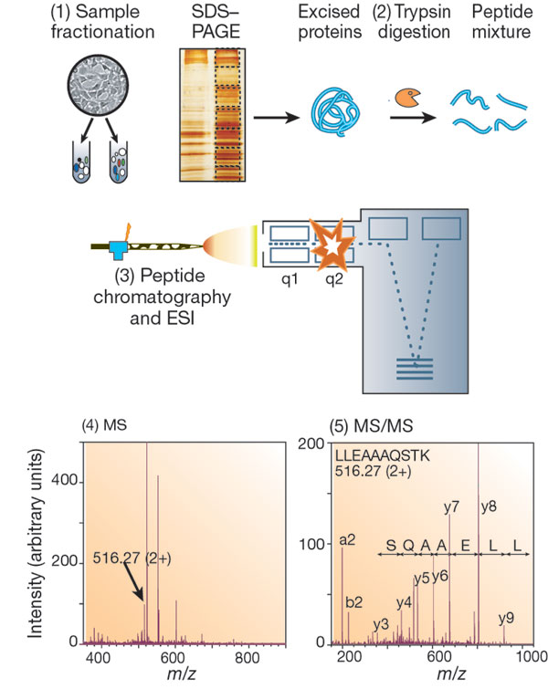
Typical MS experiment (I)
Protein Identification (and quantitation)

Slide 6
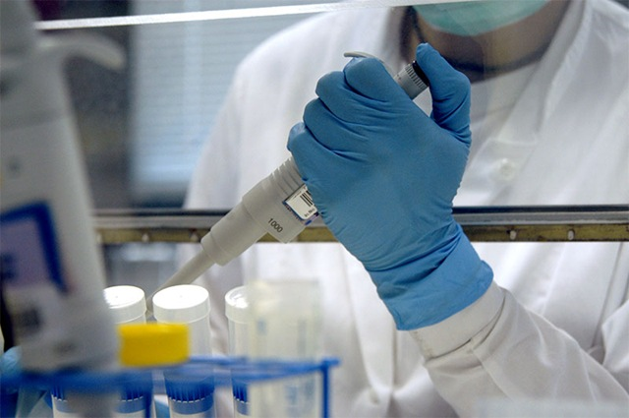
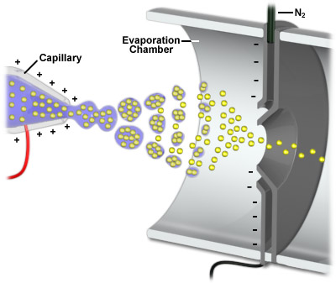
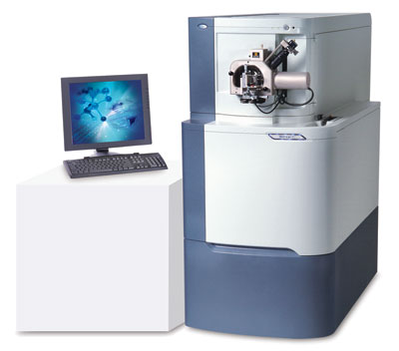
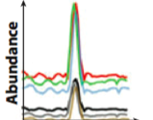
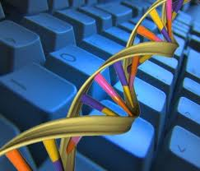
Typical MS experiment (II)
Sample preparation
Separation
Ionisation
Identification
Quantification
Cells, tissue
HPLC
MALDI, ESI
TOF, Q, IT
Algorithms
Bioanalytics
Bioinformatics
Notes:
Sample preparation: cells, body fluids, tissues
Chromatography electrophoresis
• different combinations: accuracy, sensitivity, mass range …
secondary electron multiplier
micro channel plates
time-of-flight (TOF)
quadrupol (Q)
ion trap (IT)
fourier transform ion cyclotron (FTICR)

Slide 7
Mass Spectrometry (MS) Stages
Introduce sample to the instrument
Generate ions in the gas phase
Separate ions on the basis of differences in m/z with a mass analyzer
Detect ions
Vacuum System
Samples
HPLC
Ionisation Method
Mass Analyser
Data System
Detector
MALDI
ESI

Slide 8
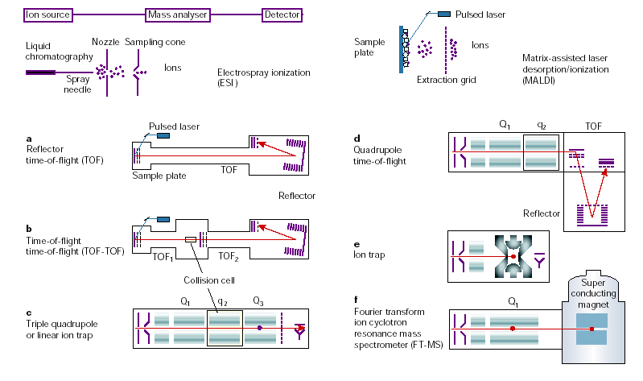
Mass spectrometers used in proteomic research
Aebersold R. and Mann M., Nature (2003)

Slide 9
Data acquired - Chromatogram
100
47.64
NL: 2.83E9
TIC MS
90
RS_Contest_04
80
70
60
50
40
75.81
30
57.90
82.90
104.24
20
74.48
111.77
3.39
26.43
46.01
134.78
10
140.20
146.61
160.29
181.98
206.18
0
47.97
NL: 4.22E8
100
Base Peak m/z=
90
400.0-2000.0 F: + c
80
Full ms [
400.00-2000.00]
70
MS RS_Contest_04
60
50
83.07
40
30
70.11
82.07
46.01
85.56
102.41
126.89
20
43.63
134.78
10
29.48
144.13
19.24
27.29
163.97
172.59
181.98
197.48
0
0
20
40
60
80
100
120
140
160
180
200
Time (min)

Slide 11
Tandem mass spectrum

Slide 12
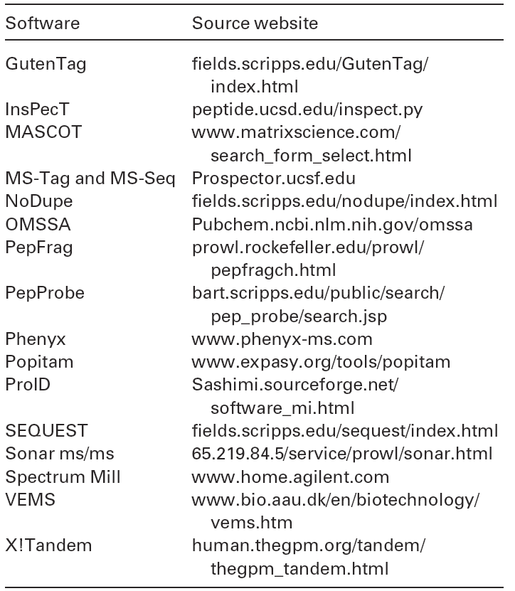
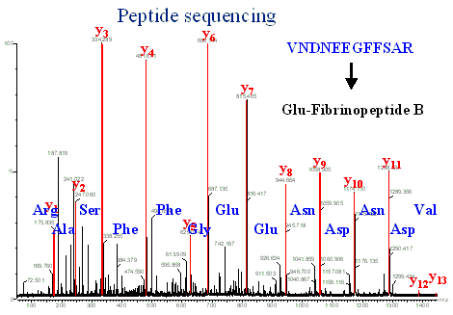
Tandem mass spectra (MS/MS) can be used for peptide sequencing
- Database Searching
- De novo sequencing

Slide 13
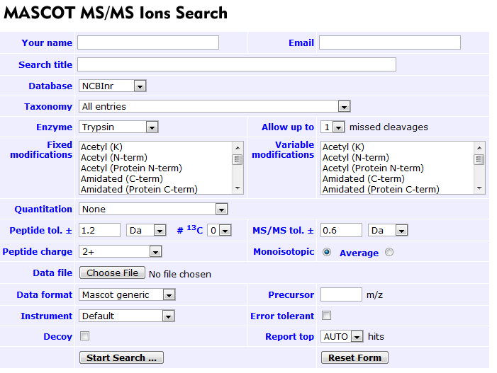
Mascot
Scoring based on peptide frequency distribution from a non-redundant database (MOWSE – Molecular Weight SEarch)
The significance of that result depends on the size of the database being searched. Mascot shades in green the insignificant hits using a P=0.05 cutoff.

Slide 14
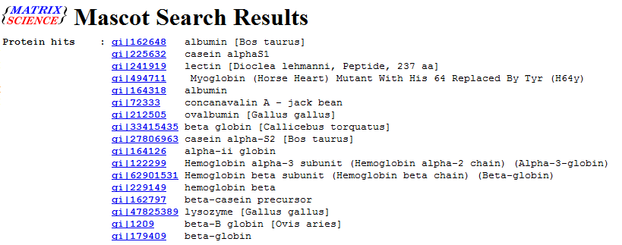
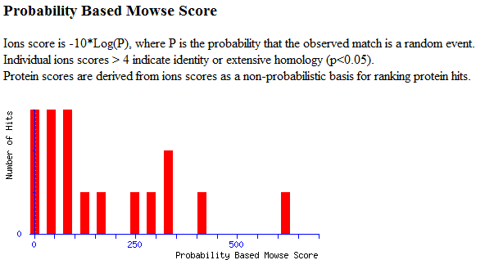

Slide 15
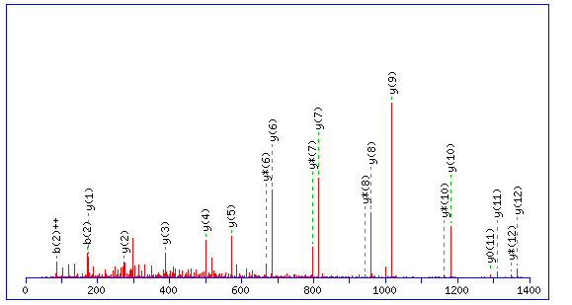
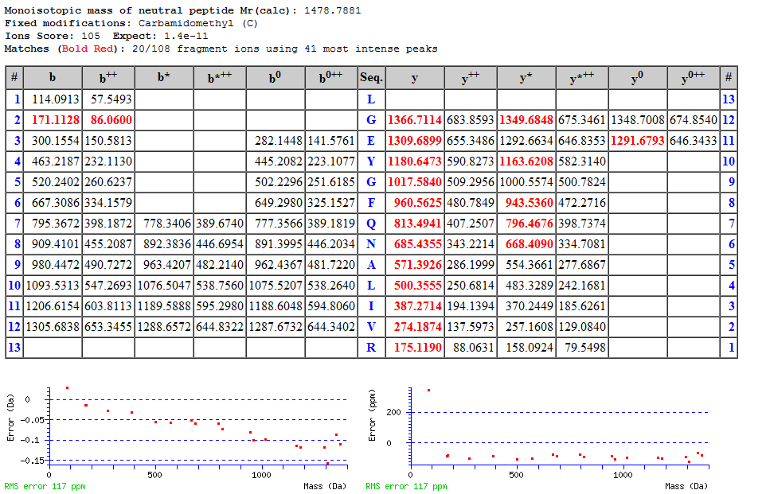

Slide 16
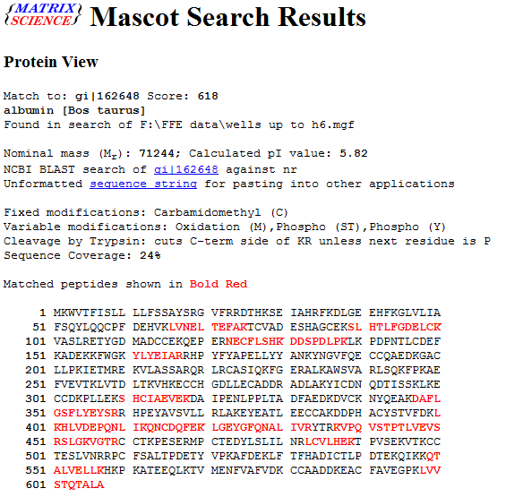

Slide 17
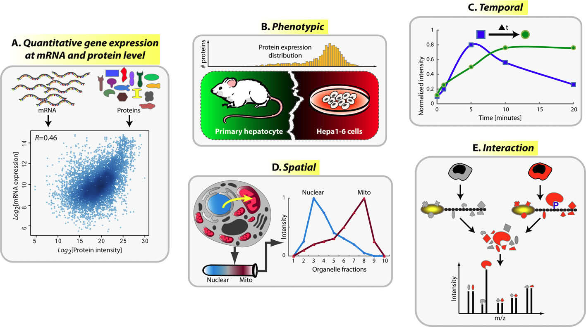
Quantitative Proteomics
Kumar et al., FEBS Letters (2009)

Slide 18
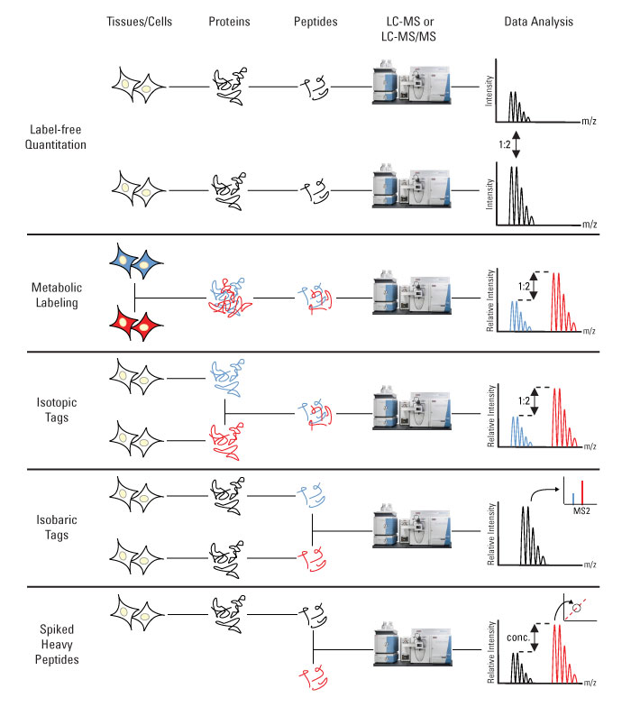
Relative quantitation methods
i.e. SILAC
i.e. ICAT
i.e. iTRAQ,
TMT

Slide 19
Quantitation methods (II)
Isotopic labeling
Label-free analysis
Yates JR, et al. Annu Rev Biomed Eng. (2009)

Slide 20
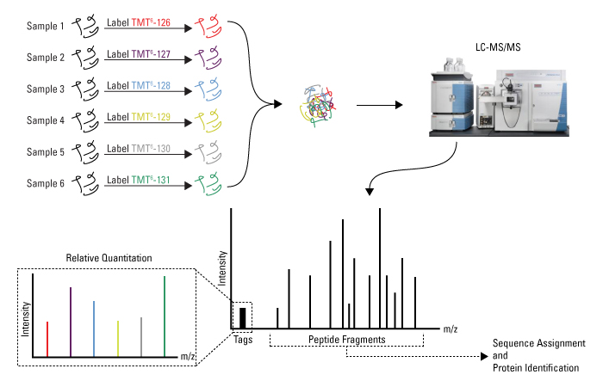
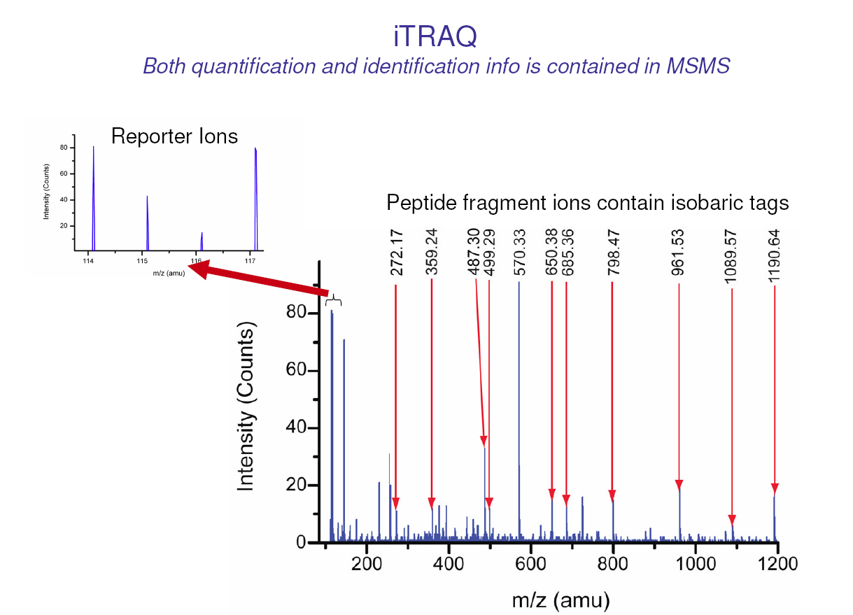
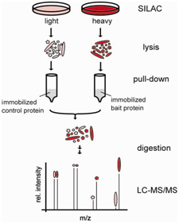
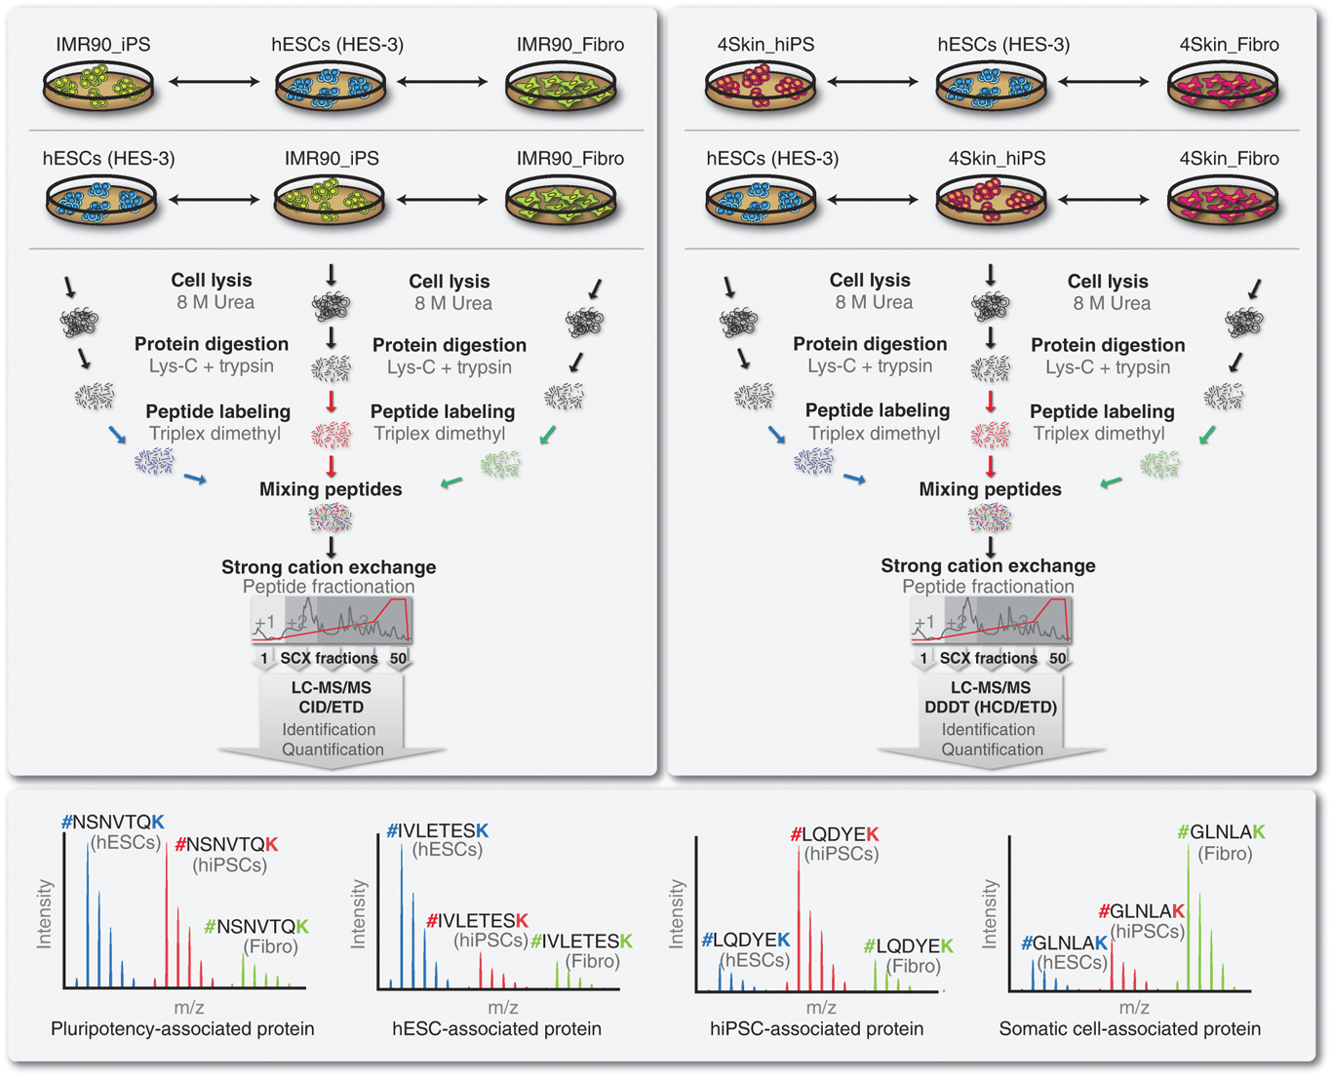
Quantitation methods (III)

Slide 21
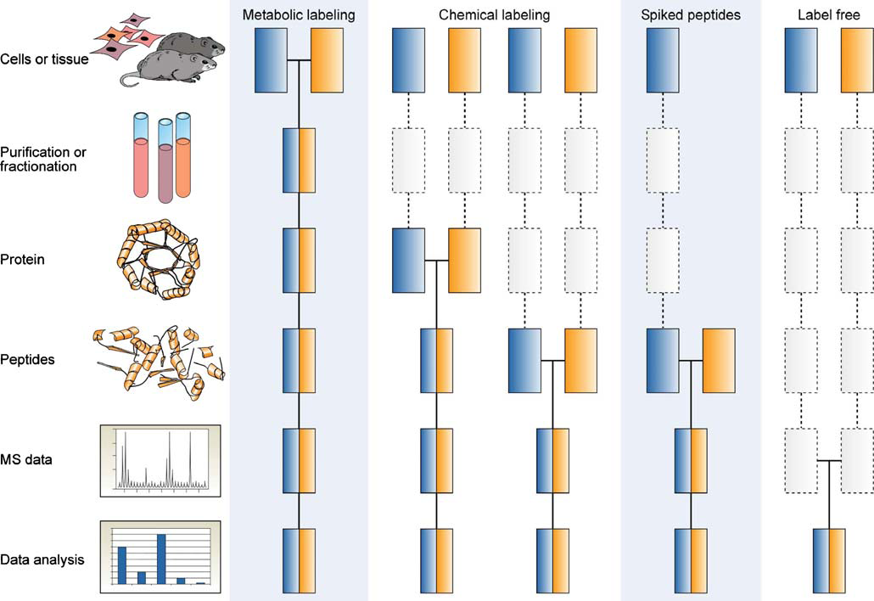
Common quantitative MS workflows
Boxes in blue and yellow represent two experimental conditions. Horizontal lines indicate when samples are combined.
Dashed lines indicate points at which experimental variation and thus quantification errors can occur.
Bantscheff et al., Anal Bioanal Chem (2007)

Slide 22
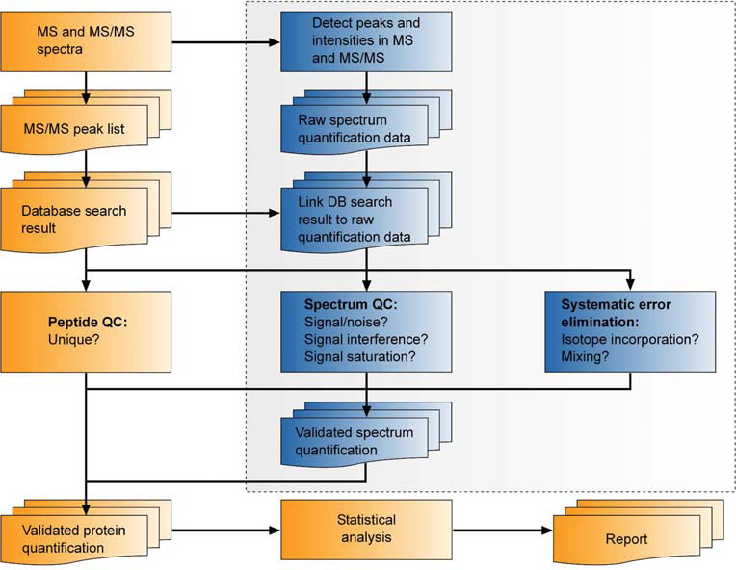
Generic data processing and analysis workflow for quantitative MS
Yellow icons indicate steps common to all quantification approaches with or without the use of stable isotopes. Blue icons in the boxed area refer to extra steps required when using mass spectrometric signal intensity values for quantification.
Bantscheff et al., Anal Bioanal Chem (2007)

Slide 23
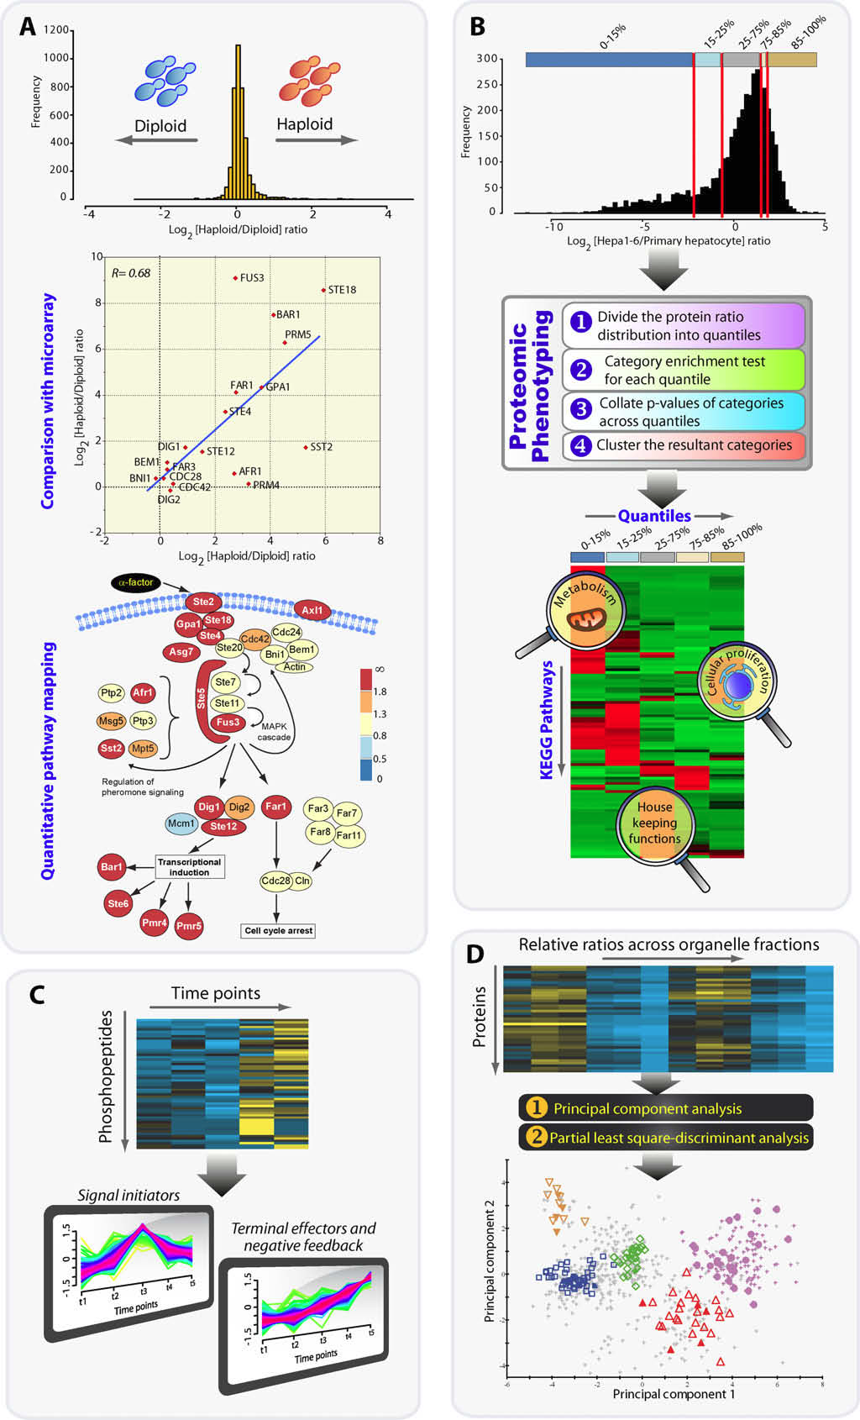
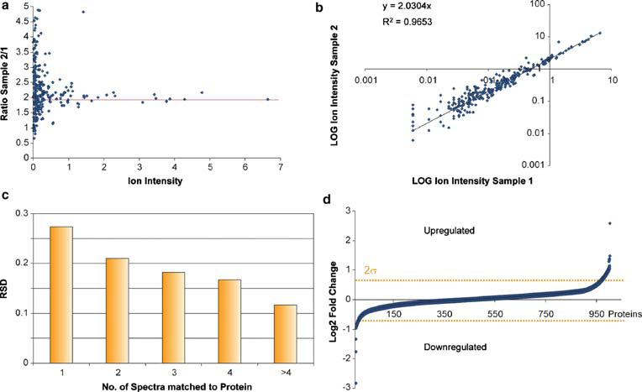
Exploring quantitative proteomics data using bioinformatics
Bantscheff et al., Anal Bioanal Chem (2007)
Kumar et al., FEBS Letters (2009)

Slide 24
Protein Quantitation Tool
APEX protein abundance estimate from LC-MS/MS data Java
ASAPRatio (TPP) statistical analysis of protein ratios from ICAT, cICAT, SILAC experiments C++
DAnTE protein quantitation, statistical analysis and visualization .NET, R
isobar quantitation of TMT and iTRAQ data and LaTeX report generation R
IsobariQ quantitation of IPTL, iTRAQ and TMT-labeled peptides C++
Libra (TPP) analyzes 4- and 8-channel iTRAQ data
MaxQuant quantitation from SILAC data from Thermo Orbitrap and FTICR
MFPaQ Mascot file parsing and quantitation using ICAT and SILAC Perl/.NET
MSQuant protein quantitation combining Mascot results and raw data from stable isotope labeling .NET
MS-Spectre quantitiave analysis of multiple LC-MS(/MS) analyses in mzXML Java
Multi-Q tool for multiplexed iTRAQ-based quantitation .NET/Perl
muxQuant multiplexed quantitiave proteomics using differential stable isotope labeling C
PEAKS Q peptide/protein quantification by iTRAQ, ICAT, SILAC or label-free Java
pepXML2Excel converts output from PeptideProphet to protein level information in Excel AWK
ProRata differential proteomics analysis using for various stable isotope labeling schemes
PVIEW isotope labeled, label-free, XIC-based quantitation C++
Quant MATLAB program for protein quantitation by iTRAQ MATLAB
QUIL another program for relative quantitation using stable isotope labeling
RAAMS algorithm for interpreting O-16/O-18 differential proteomics data C++
RelEx calculation of ion current ratios from LC-MS data (requires Xcalibur)
XPRESS (TPP) calculates relative abundances from ICAT, cICAT, SILAC and other N-14/N-15 experiments
Msnbase Base Functions and Classes for MS-based Proteomics R
…

Slide 25
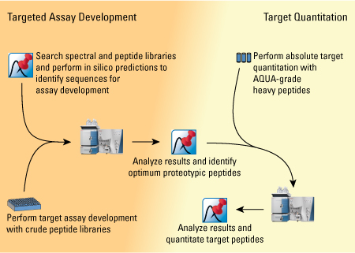
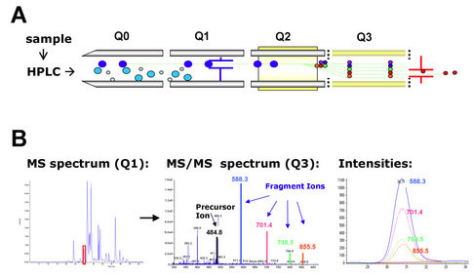
Absolute quantitation (targeted proteomics)
Selected reaction monitoring (SRM) or multiple reaction monitoring (MRM) is a method of absolute quantitation (also terms AQUA) in targeted proteomics analyses that is performed by spiking complex samples with stable isotope-labeled synthetic peptides that act as internal standards for specific peptides

