Slide 1
Study of human mouth microbiome
as a large citizen science project
Julia Ponomarenko, CRG Bioinformatics Core

Slide 2
What is Saca La Lengua?
How did we get data and what data?
How did we analyze them?
Benchmarking different pipelines on MOCK samples
Pilot study involving CRG people
Saca la Lengua study: preliminary results

Slide 3

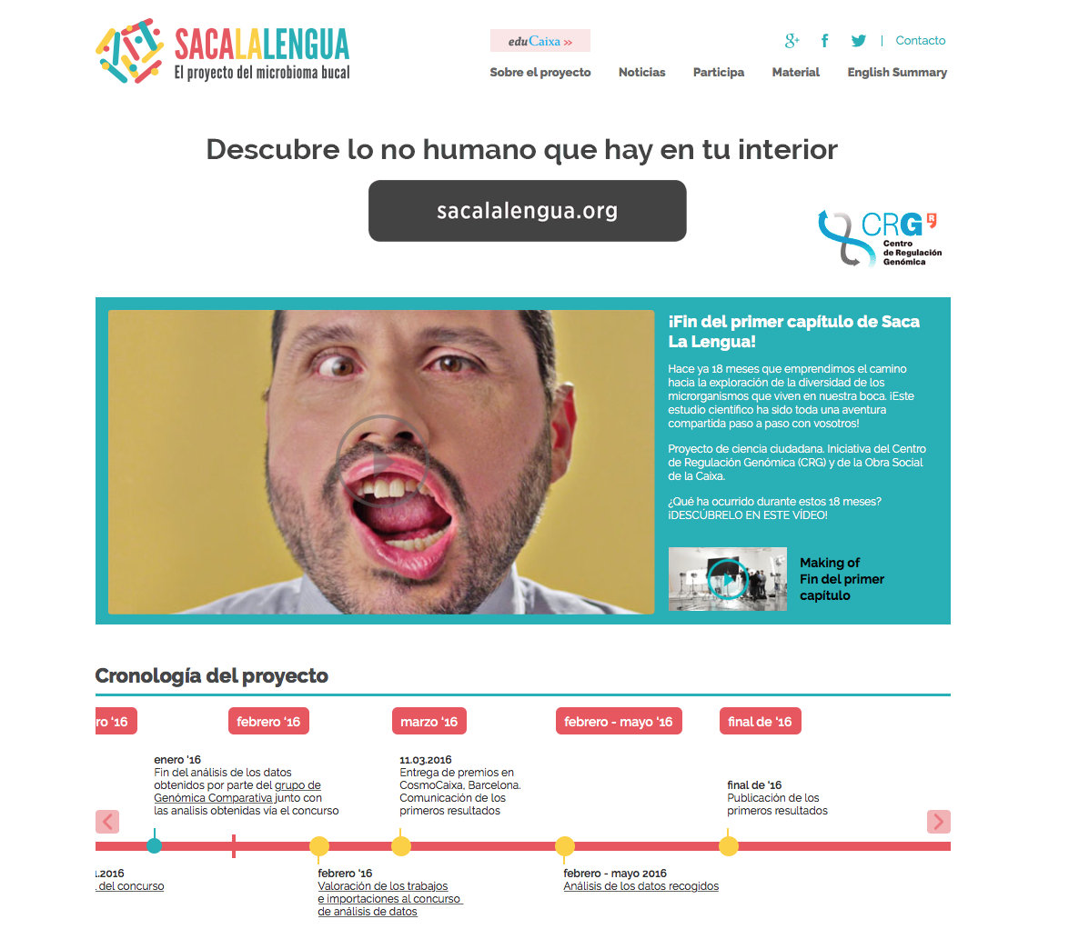

Slide 4
Why is the mouth?
One of the most clinically relevant human body niche.
Direct contact to environment entry point to digestive system, upper airways.
Common mouth diseases related to micro-organisms include caries, periodontal diseases, halitosis, dental plaque.
Risk factor to many diseases, such as cardiovascular diseases, diabetes, bacteremia, preterm birth, allergy, asthma.
50% of oral bacteria are unculturable.
Mouth comprises of several micro-environments: dental plaque, tongue, saliva.

Slide 5

versus previous studies
Focus on a delimited age (young), versus “adults”.
1582 individuals were sampled from the same country vs. 100-300 samples (10-20 per country).
Rural versus City environment directly addressed.
Other variables addressed: diet, sugary drinks, hygiene habits, etc.
Focus on bacteria and fungi, versus only bacteria. More than 700 distinct bacteria have been identified in mouth.
Previous studies have found no obvious link to geography but large inter-individual variation in bacterial profiles.

Slide 6
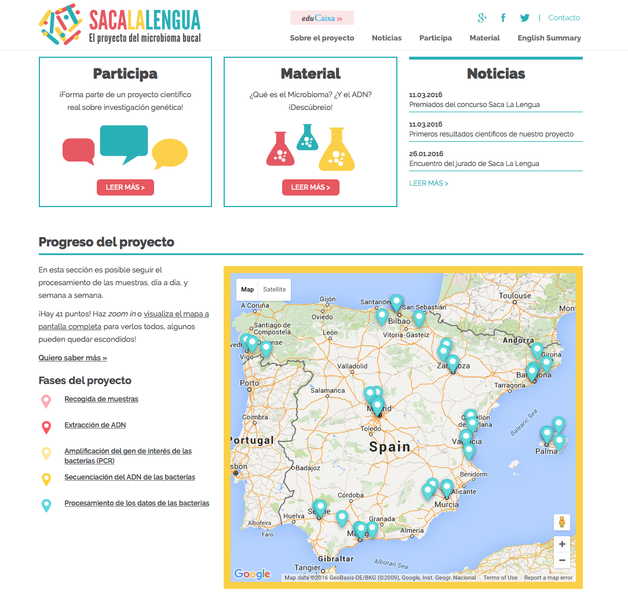

Slide 7
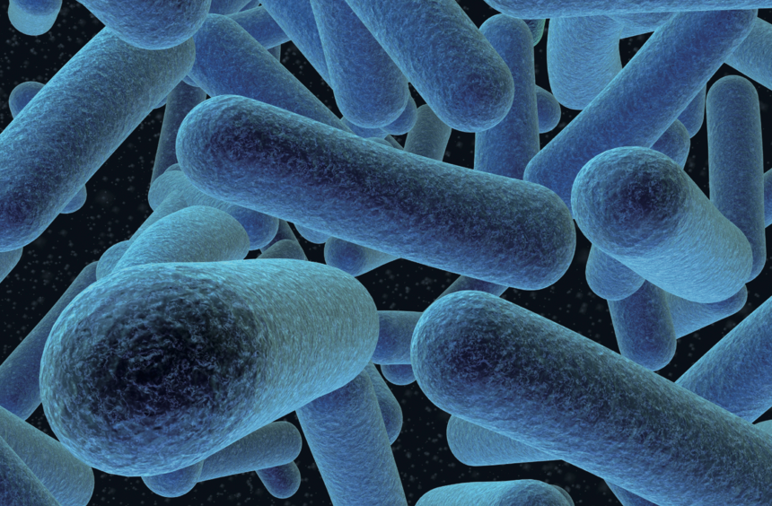
Bacterial Taxonomic Classification
Kingdom: Bacteria
Phylum: Firmicutes
Class: Bacilli
Order: Bacillales
Family: Listeriaceae
Genus: Listeria
Species: L. marthii

Slide 8
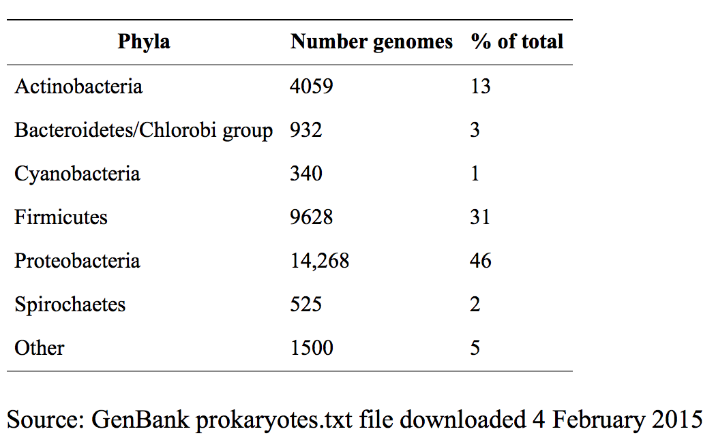
More than 30,000 bacterial genomes have been sequenced so far

Slide 9
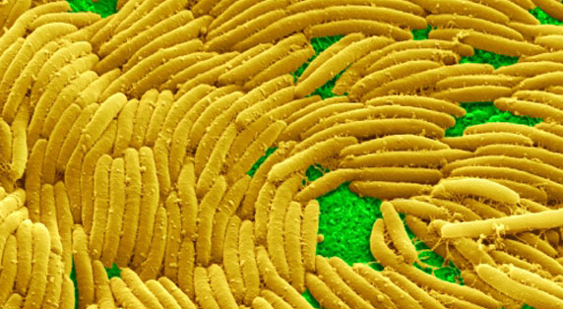
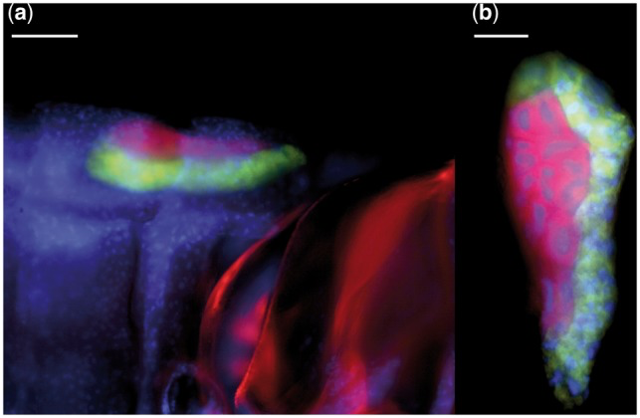
A “typical” bacterial genome is around 5 million bp and encodes about 5000 proteins
Sorangium cellulosum strain So0157-2 has the largest genome of 14,782,125 bp containing 11,599 genes
Candidatus Nasuia deltocephalinicola strain NAS-ALF has the smallest bacterial genome sequenced of 112,091 bp containing 137 proteins

Slide 10
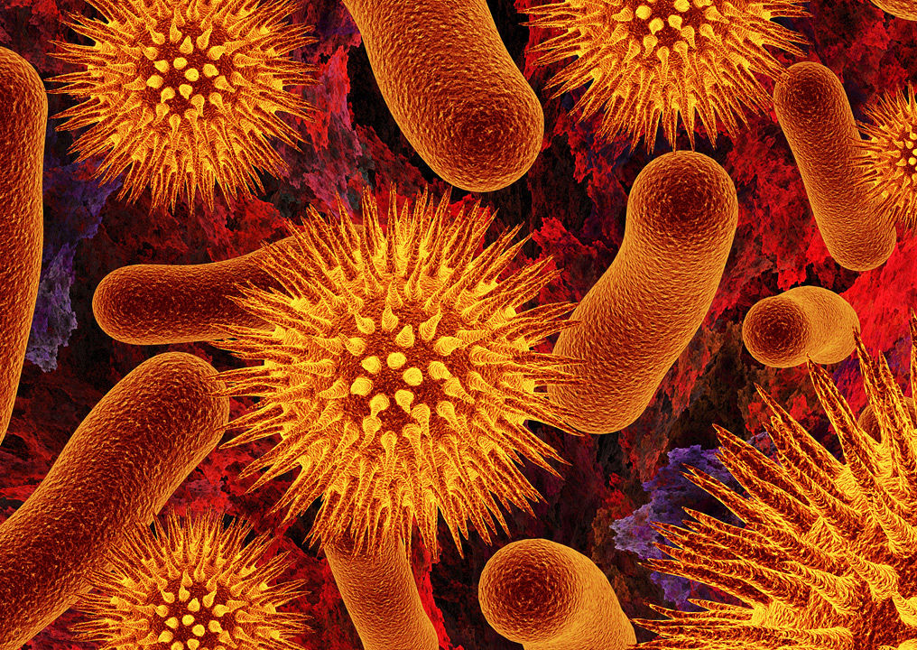
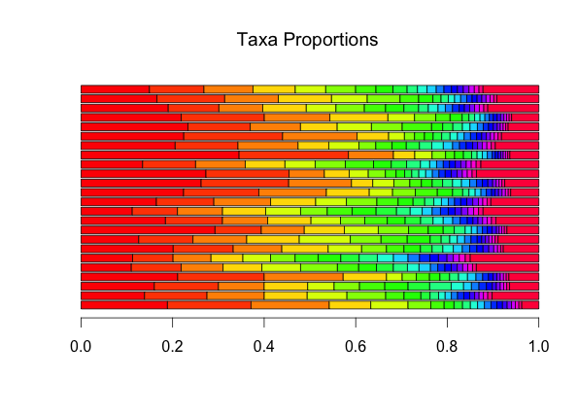
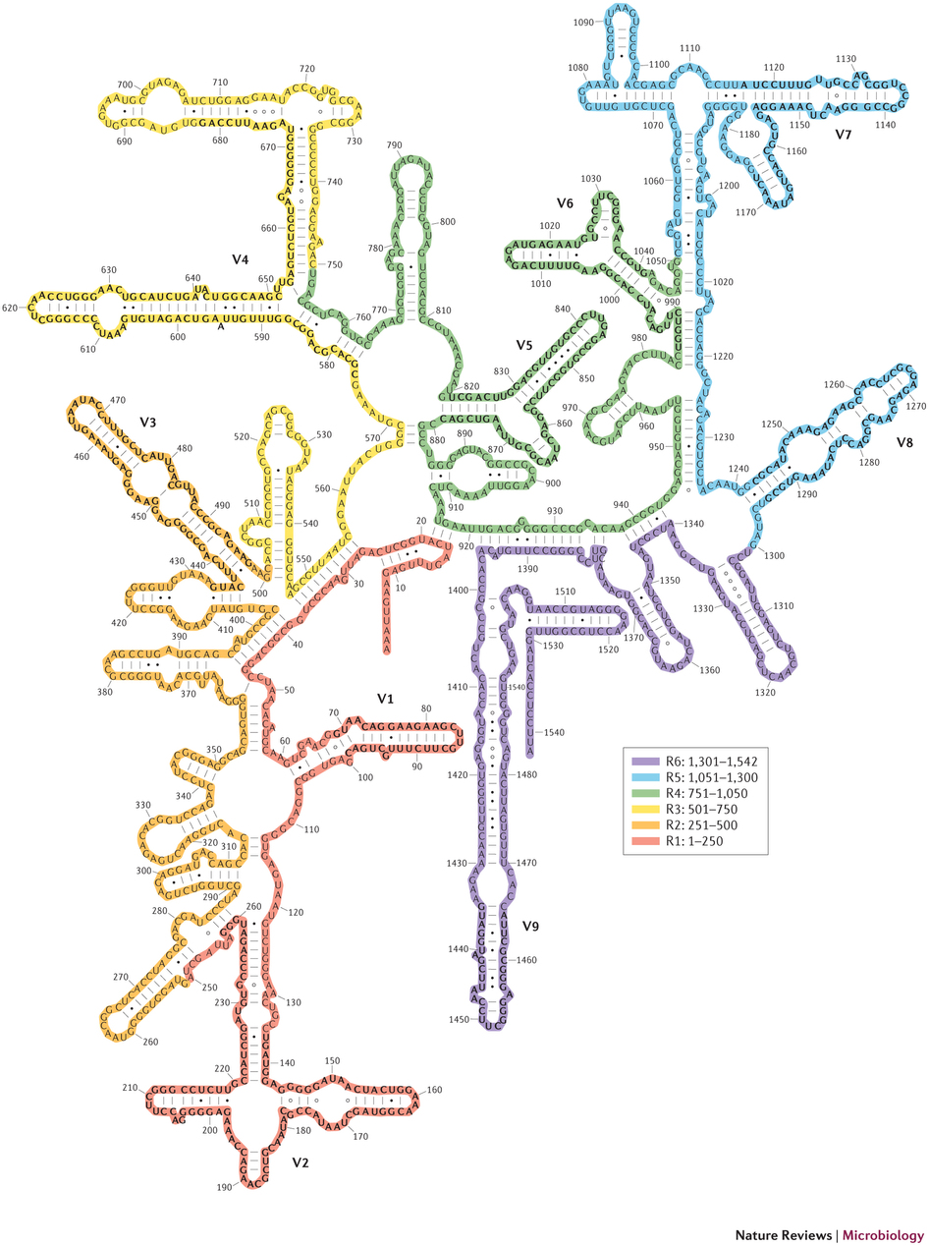
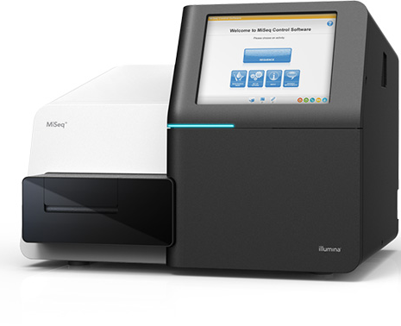
Bacterial community analysis
Sample
Proportion of different taxa
16S rRNA (V3/V4 primers)
MiSeq
Notes:
What is meant by taxa proportions or abundaces?
The extracted DNA was used as a template for the amplification of the V3-V4 regions of the 16S rRNA gene using the universal primers, V3-V4 Forward (5'-TCGTCGGCAGCGTCAGATGTGTATAAGAGACAGCCTACGGGNGGCWGCAG-3') and V3-V4 Reverse (5'-GTCTCGTGGGCTCGGAGATGTGTATAAGAGACAGGACTACHV GGGTATCTAATCC-3'), in a limited cycle PCR.

Slide 11
Why is 16S rRNA?
16S rRNA gene is unique to prokaryotes and found in all bacteria and archaea.
16S rRNA gene is relatively short at 1.5 kb, making it faster and cheaper to sequence than many other unique bacterial genes.
Ribosomes (and correspondingly the DNA that codes for them) have been mostly conserved over time, due to their important function, translating mRNA into proteins.
16S genes have been sequenced for more than 1.5 Million bacterial species (SILVA database).

Slide 12
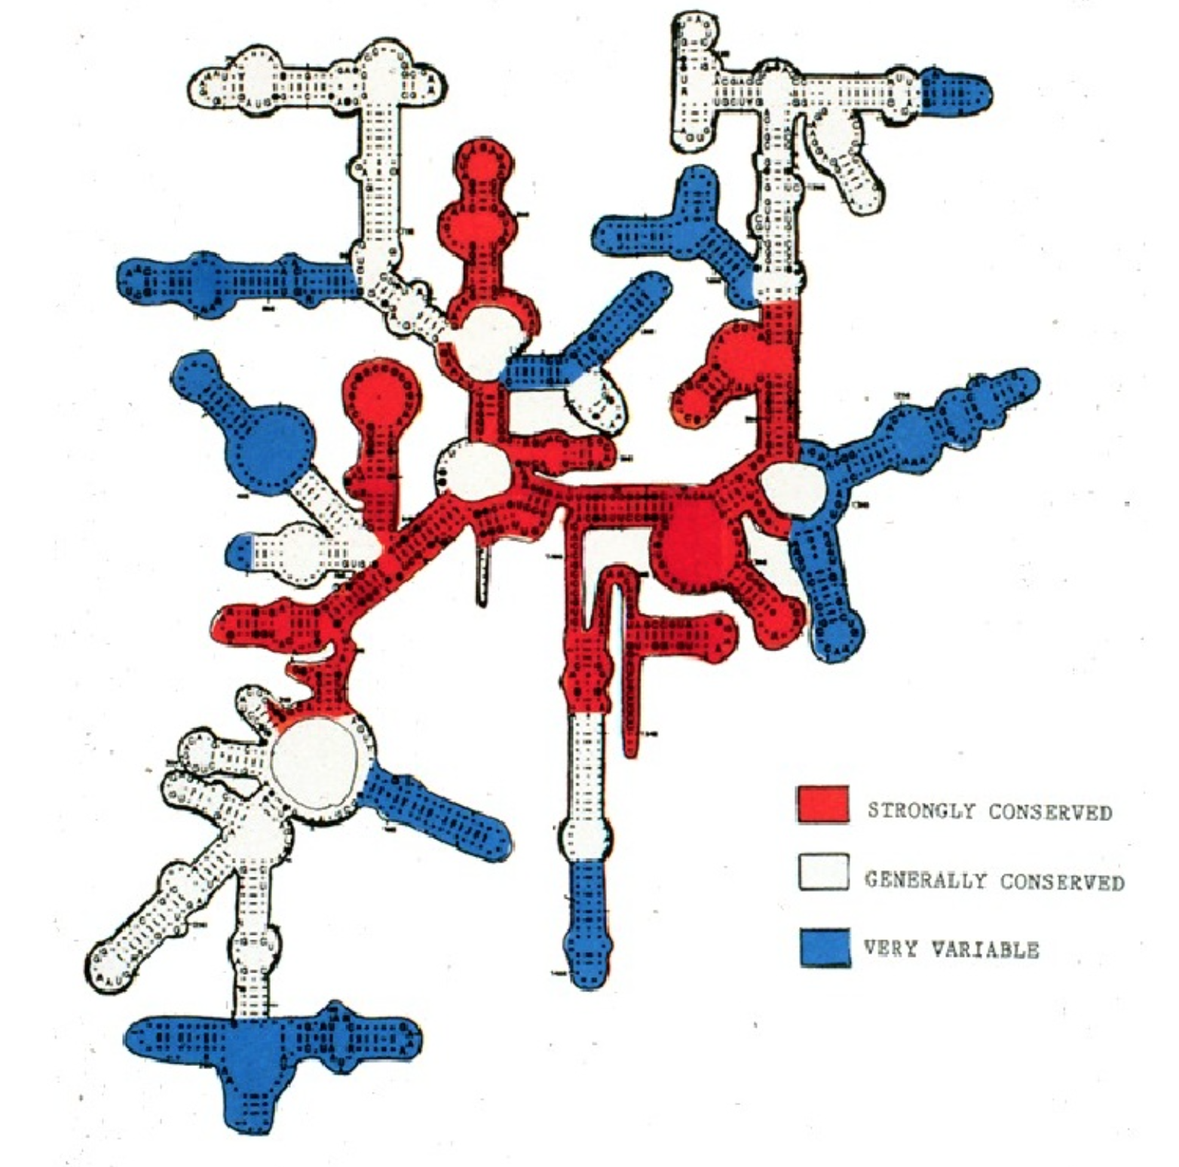
In addition to highly conserved primer binding sites, 16S rRNA gene sequences contain nine hypervariable regions (V1 – V9) that can provide species-specific signatures useful for bacteria identification

Slide 13
16S V3-V4 region (433-497, 576-682) contains both the most and least variable sequences

Slide 14
Alignment of 16S V3-V4 regions of three species of the genus Staphylococcus and two species of the genus Macrococcus of the same family Staphylococcaceae
V3
V4

Slide 15
Caveats of using 16S rRNA gene
No single region can differentiate among all bacteria; thus, V2 best distinguishes among Mycobacterial species, V3 among Haemophilus species.
Bacteria have from 1 to 15 copies of 16S genes depending on species.
Analysis pipelines usually produce estimates of per-taxon relative abundances based on the number of copies of 16S genes recovered in a sequence library.
The degree to which this assumption is warranted, and the effect of treating 16S gene abundance as a surrogate measure of organismal abundance on estimates of microbial community structure is unknown.
Thus, variation in 16S gene abundances can be caused by both genomic copy number variation and variation in the abundance of organisms.
There are approaches correcting for copy number of 16S genes. However, this number is known for 2% of bacterial species (30,000 fully sequenced genomes vs. 1,500,000 16S sequenced genes).
This can be a source of systematic bias in 16S surveys, along with differential DNA extraction and polymerase chain reaction amplification.

Slide 16
Alternatives to 16S rRNA sequencing
To sequence along with 16S rRNA the gene(s) present in a single copy per genome.
cpn60 gene is a good candidate: 555bp long, can be amplified with a universal PCR primer, mutations are uniform along the gene, shows lower sequence identity among species than 16S.
WGS and de novo assembly.

Slide 17
Amplicon sequencing workflow
450-460 bases
bac1
V3-V4 variable sequence
bac2
Bacterial universal primers

Slide 18
Amplicon sequencing workflow
Index1
bac1
V3-V4 variable sequence
bac2
Index2
Indexes for distinguishing the samples
(8 nucleotides)

Slide 19
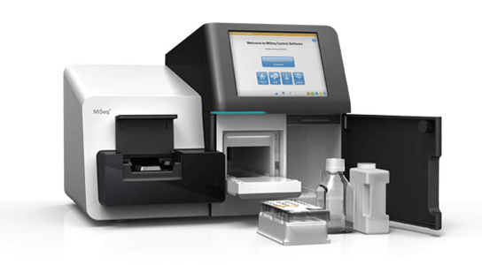
Amplicon sequencing workflow
Nextera P5
Index1
bac1
V3-V4 variable sequence
bac2
Index2
Nextera P7
Illumina adapters for sequencing with MiSeq

Slide 20
Amplicon sequencing workflow
Nextera P5
Index1
bac1
V3-V4 variable sequence
bac2
Index2
Nextera P7
301 bp
Overlap
301 bp
148-152 bp overlap

Slide 21

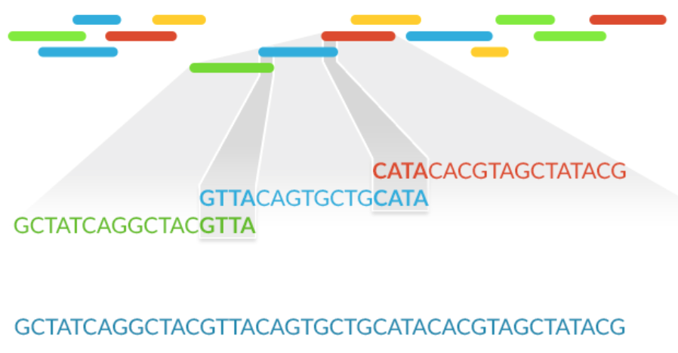
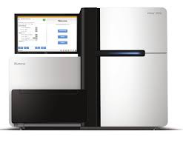
Sequencing of MOCK bacterial communities (even and staggered number of rrn operons)
16S (V3/V4 primers)
20 species with known genomes
WGS
MiSeq
HiSeq
Counting the number of operons and abundance for each species
Notes:
Bacterial 16S ribosomal RNA, 23S ribosomal RNA, and 5S rRNA genes are typically organized as a co-transcribed operon.
There may be one or more copies of the operon dispersed in the genome (for example, Escherichia coli has seven).

Slide 22
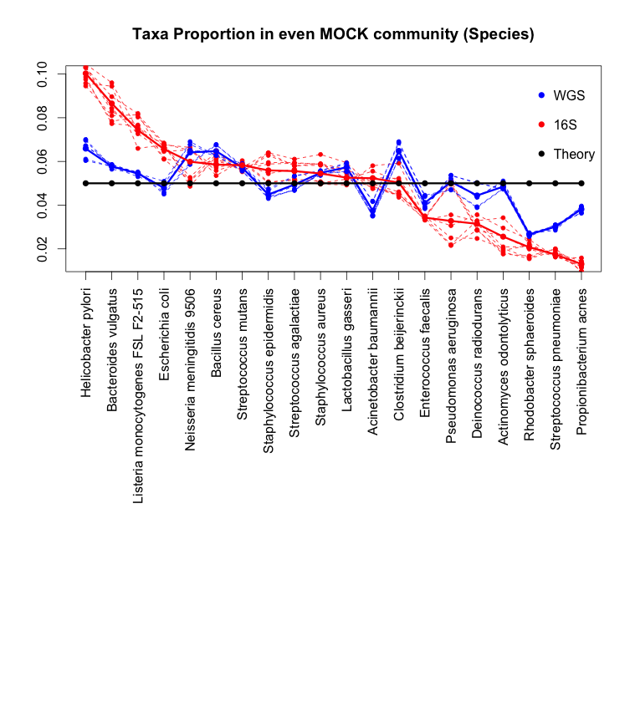
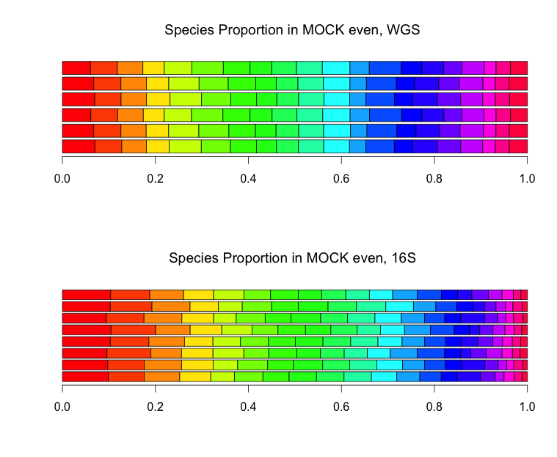
Species abundances were significantly different between 16S and WGS approaches: Even MOCK

Slide 23
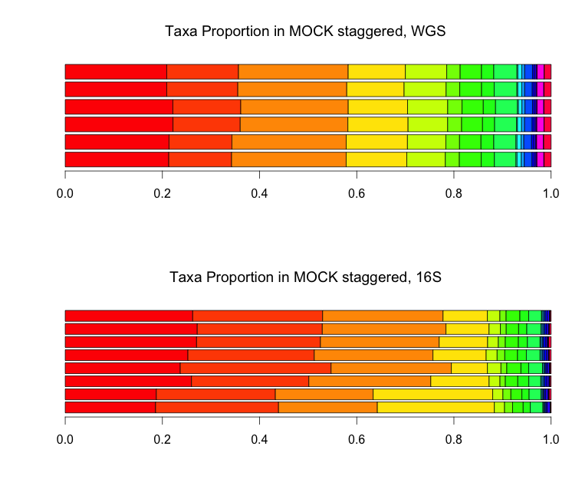
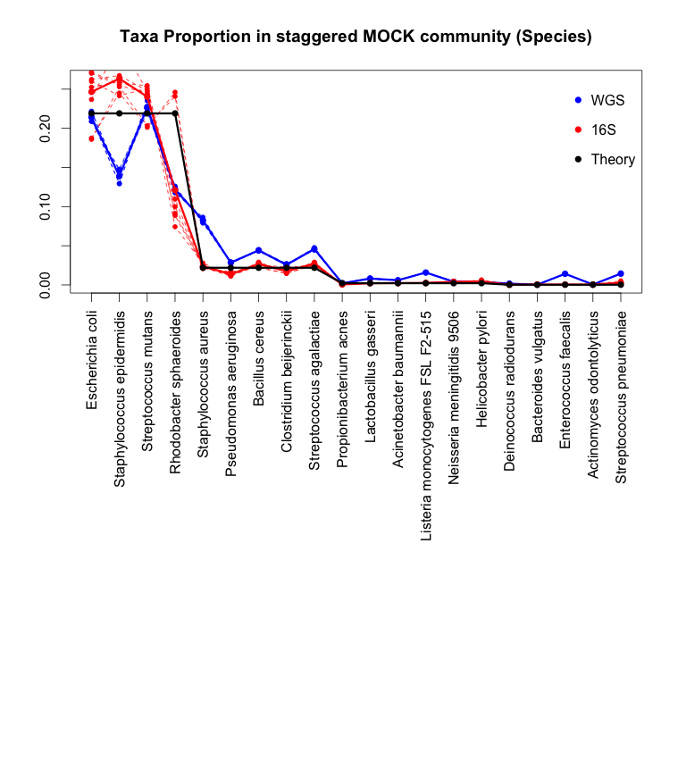
Species abundances were significantly different between 16S and WGS approaches: Staggered MOCK

Slide 24
Bacterial community analysis based on 16S
Sample
Proportion of different taxa
Mothur
RiboPicker
QIIME
QUPARSE
16S rRNA (V3/V4 primers)
MiSeq
Notes:
What is meant by taxa proportions or abundaces?
The extracted DNA was used as a template for the amplification of the V3-V4 regions of the 16S rRNA gene using the universal primers, V3-V4 Forward (5'-TCGTCGGCAGCGTCAGATGTGTATAAGAGACAGCCTACGGGNGGCWGCAG-3') and V3-V4 Reverse (5'-GTCTCGTGGGCTCGGAGATGTGTATAAGAGACAGGACTACHV GGGTATCTAATCC-3'), in a limited cycle PCR.

Slide 25
16S analysis benchmarking
Eight independent (the same MiSeq) runs were performed for sequencing the even and staggered MOCK communities of 20 species (HMP).
Reads were mapped to 20 reference bacterial genomes using Bowtie2.
Four bioinformatics pipelines – mothur, QIIME, Riboicker (based on the skewer, pear and ribopicker algorithms), QUPARSE (UPARSE imported into QIIME) – were set up and tested.
Taxonomic annotations on globally trimmed non-chimeric representative sequences in QIIME, mothur, and Ribopicker were performed by the RDP Classifier using the SILVA database with ≥90% bootstrap confidence. In QUPARSE, the GreenGenes Database was used.
Performance of the methods were evaluated using the HMP parametric R statistical package.

Slide 26
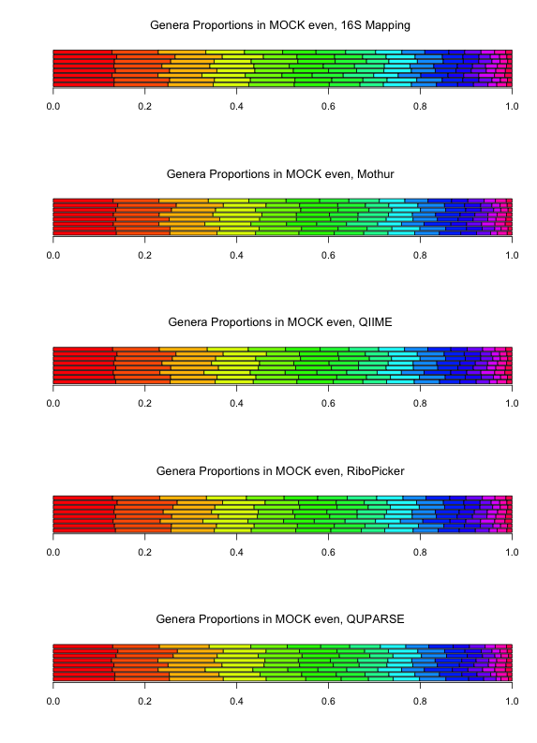
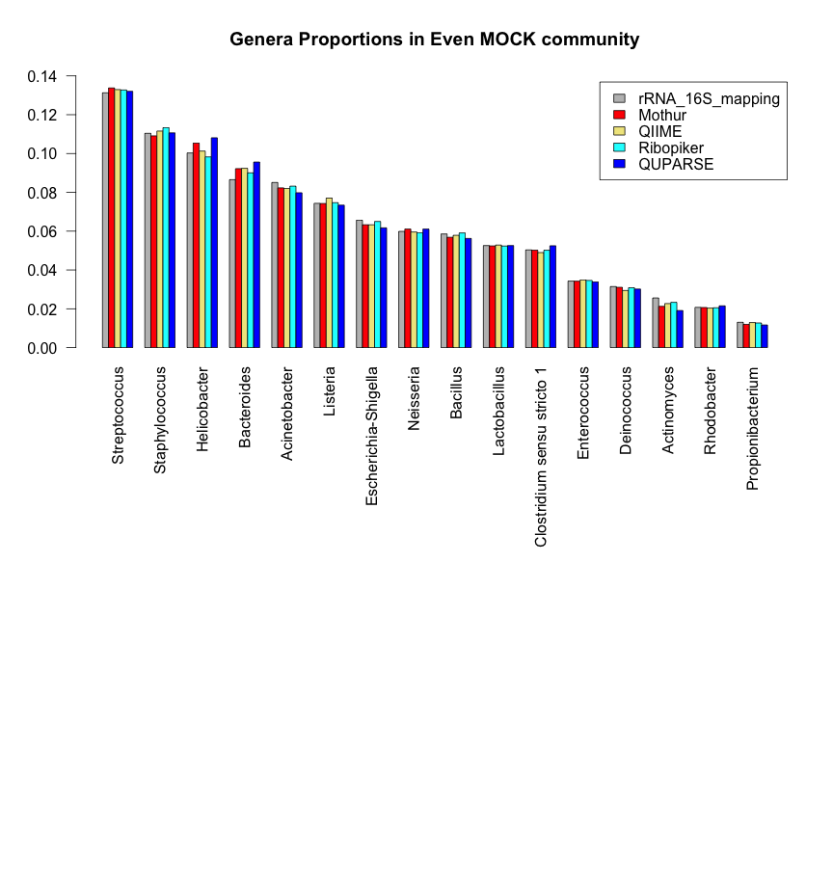
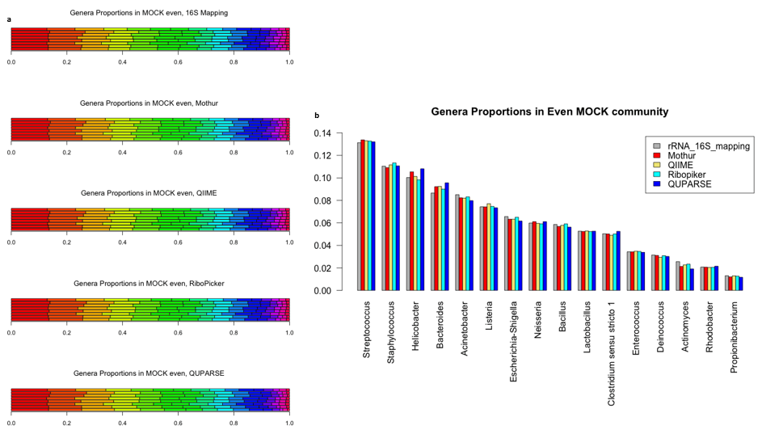
All but QUPARSE distributions were not significantly different from 16S mapping data: Even MOCK
QUPARSE: p-value < 0.0004, based on the Likelihood-Ratio test statistic comparing the Drichlet parameter vectors.

Slide 27
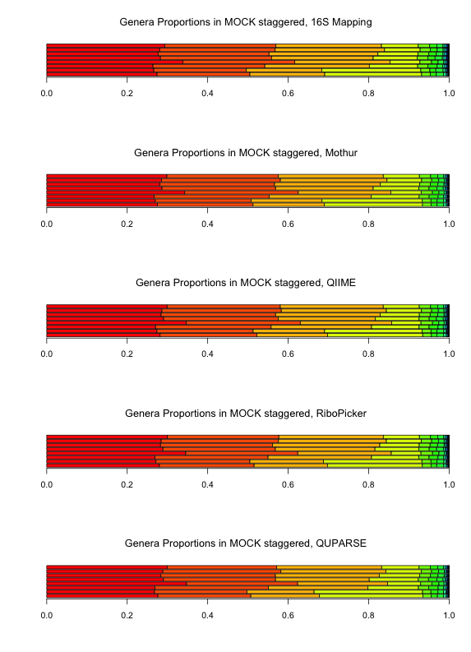
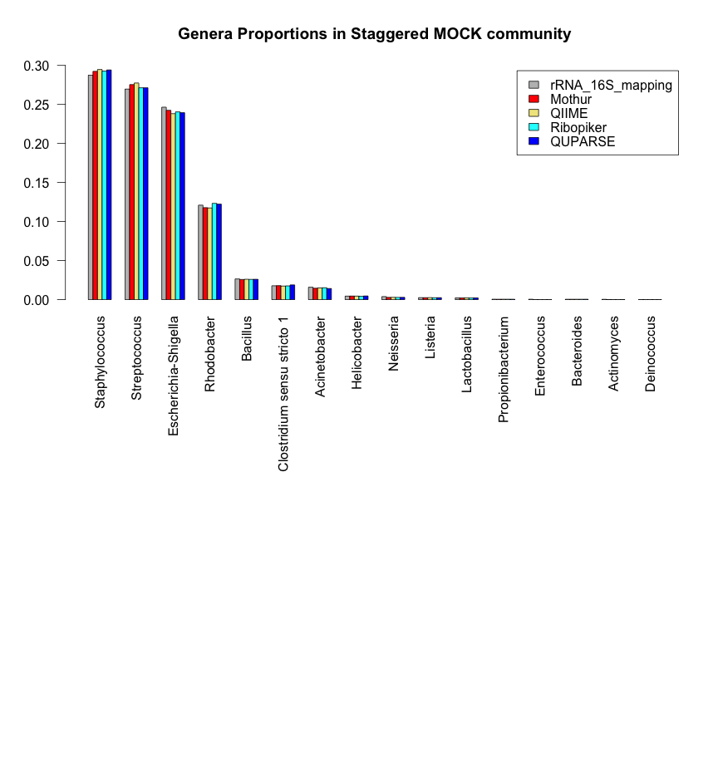
Genera abundances in Staggered MOCK estimated by all four pipelines were not significantly different from 16S mapping data

Slide 28
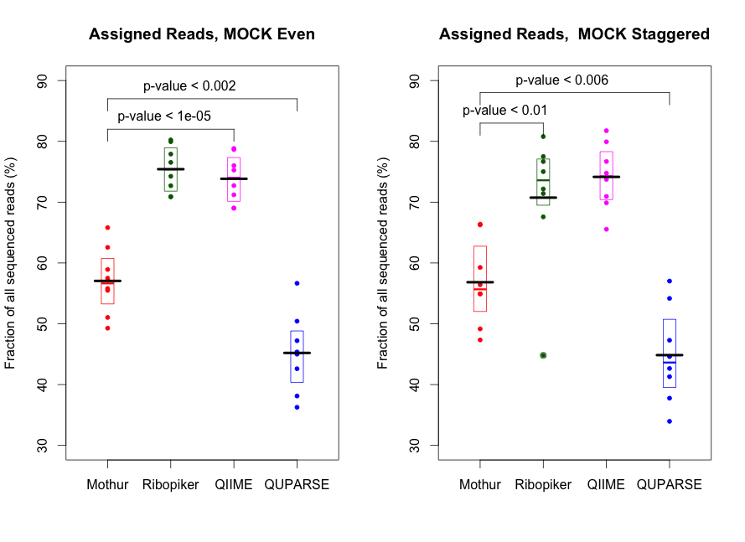
For both even and staggered MOCK, QIIME and Ribopiker assigned more than 70% of sequenced reads, which was significantly more than Mothur or QUPARSE did. QUPARSE performed the worst, leaving more than a half sequenced reads unassigned.

Slide 29
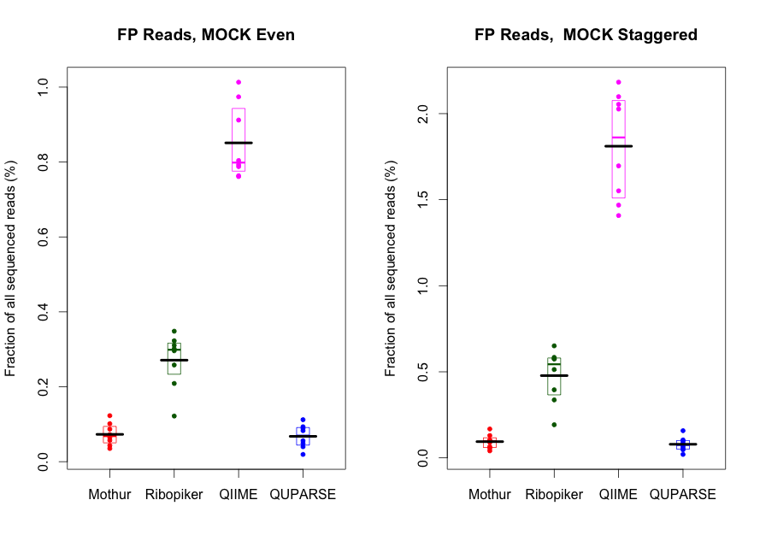
Percentage of false-positively assigned reads was low in all tested methods.

Slide 30
A note on counting FP
We are not interested in genera to which a very low number of reads were assigned.
Am abundance threshold must be always imposed.
For example, in MOCK Staggered, the lowest abundance is 0.022% (for four genera).
Also, one of a very commonly used threshold for pooling rare taxa is 1%.

Slide 31
Even MOCK, threshold on genera abundance of 1% and 0.022%
 |  | data2 | data3 | data4ra | data5ra | data6ra | data7 | data8 | data9
Threshold on abundance 1%
FN genera | Mothur | 0 | 1 | 0 | 0 | 0 | 1 | 0 | 0
 | Ribopiker | 0 | 1 | 0 | 0 | 0 | 1 | 0 | 0
 | QIIME | 0 | 1 | 0 | 0 | 0 | 1 | 0 | 0
 | QUPARSE | 0 | 1 | 0 | 0 | 0 | 1 | 0 | 0
FP genera | Mothur | 0 | 0 | 0 | 0 | 0 | 0 | 0 | 0
 | Ribopiker | 0 | 0 | 0 | 0 | 0 | 0 | 0 | 0
 | QIIME | 0 | 0 | 0 | 0 | 0 | 0 | 0 | 0
 | QUPARSE | 0 | 0 | 0 | 0 | 0 | 0 | 0 | 0
Threshold on abundance 0.022%
FN genera | Mothur | 0 | 0 | 0 | 0 | 0 | 0 | 0 | 0
 | Ribopiker | 0 | 0 | 0 | 0 | 0 | 0 | 0 | 0
 | QIIME | 0 | 0 | 0 | 0 | 0 | 0 | 0 | 0
 | QUPARSE | 0 | 0 | 0 | 0 | 0 | 0 | 0 | 0
FP genera | Mothur | 1 | 1 | 0 | 0 | 1 | 1 | 2 | 0
 | Ribopiker | 2 | 7 | 4 | 6 | 5 | 2 | 5 | 2
 | QIIME | 4 | 7 | 6 | 5 | 5 | 6 | 7 | 4
 | QUPARSE | 0 | 1 | 1 | 0 | 0 | 1 | 2 | 0

Slide 32
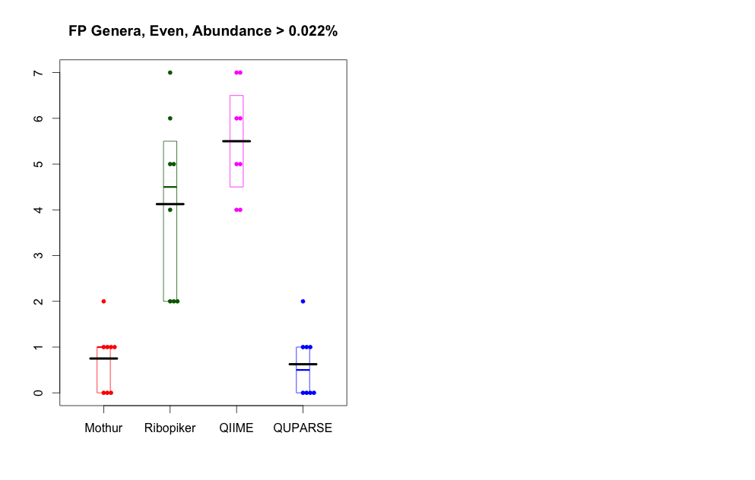
Even MOCK, threshold on genera abundance of 0.022%.
Mothur and QUPARSE gave the same number of false positive genera, which was significantly lower than QIIME or Ribopiker did (p-value < 0.001).

Slide 33
Staggered MOCK, threshold on genera abundance of 0.022% and 0.01%
 |  | data2 | data3 | data4ra | data5ra | data6ra | data7 | data8 | data9
Threshold on abundance 0.022%
FN genera | Mothur | 2 | 2 | 2 | 2 | 0 | 2 | 2 | 2
 | Ribopiker | 3 | 3 | 3 | 3 | 3 | 3 | 2 | 3
 | QIIME | 3 | 3 | 3 | 3 | 3 | 3 | 2 | 3
 | QUPARSE | 3 | 3 | 3 | 1 | 3 | 3 | 3 | 3
FP genera | Mothur | 0 | 0 | 1 | 0 | 0 | 2 | 1 | 0
 | Ribopiker | 2 | 4 | 8 | 3 | 6 | 9 | 9 | 4
 | QIIME | 5 | 8 | 9 | 7 | 10 | 11 | 9 | 6
 | QUPARSE | 0 | 0 | 1 | 0 | 0 | 4 | 1 | 0
Threshold on abundance 0.01%
FN genera | Mothur | 1 | 0 | 0 | 0 | 0 | 1 | 0 | 0
 | Ribopiker | 2 | 0 | 1 | 0 | 0 | 1 | 1 | 0
 | QIIME | 2 | 0 | 0 | 0 | 0 | 1 | 1 | 0
 | QUPARSE | 2 | 1 | 1 | 1 | 1 | 2 | 0 | 1
FP genera | Mothur | 2 | 1 | 5 | 0 | 4 | 5 | 5 | 4
 | Ribopiker | 2 | 7 | 13 | 12 | 15 | 16 | 12 | 9
 | QIIME | 5 | 11 | 11 | 11 | 13 | 16 | 12 | 10
 | QUPARSE | 1 | 1 | 3 | 1 | 4 | 4 | 4 | 1

Slide 34
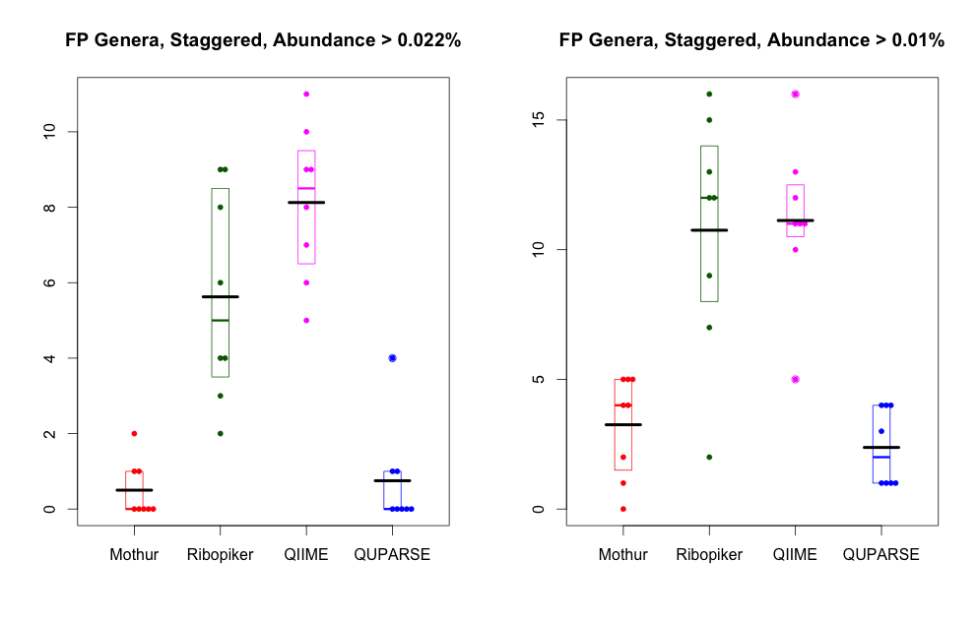
Staggered MOCK. For both thresholds on genera abundance of 0.022% and 0.01%, Mothur and QUPARSE gave the same number of false positive genera, which was significantly lower than QIIME or Ribopiker did (p-value < 0.001).

Slide 35
Among the four methods tested, the winner was ….
For the staggered MOCK data, all methods gave genera distributions that were not significantly different from the 16S rRNA sequencing genome mapping data.
Mothur and QUPARSE gave the same and significantly lower number of false positively identified genera than Ribopiker and Qiime, keeping the number of FNs also lower, at different thresholds on the genera abundance in both even and staggered MOCKs.
However, QUPARSE did not assign to any genera more than a half of sequenced reads. It also gave as not as satisfied performance as the other methods for the even MOCK.
… Mothur

Slide 36

Bacterial community analysis
Sample
Proportion of different taxa
16S rRNA (V3/V4 primers)
MiSeq
Mothur software
Notes:
What is meant by taxa proportions or abundaces?
The extracted DNA was used as a template for the amplification of the V3-V4 regions of the 16S rRNA gene using the universal primers, V3-V4 Forward (5'-TCGTCGGCAGCGTCAGATGTGTATAAGAGACAGCCTACGGGNGGCWGCAG-3') and V3-V4 Reverse (5'-GTCTCGTGGGCTCGGAGATGTGTATAAGAGACAGGACTACHV GGGTATCTAATCC-3'), in a limited cycle PCR.

Slide 37
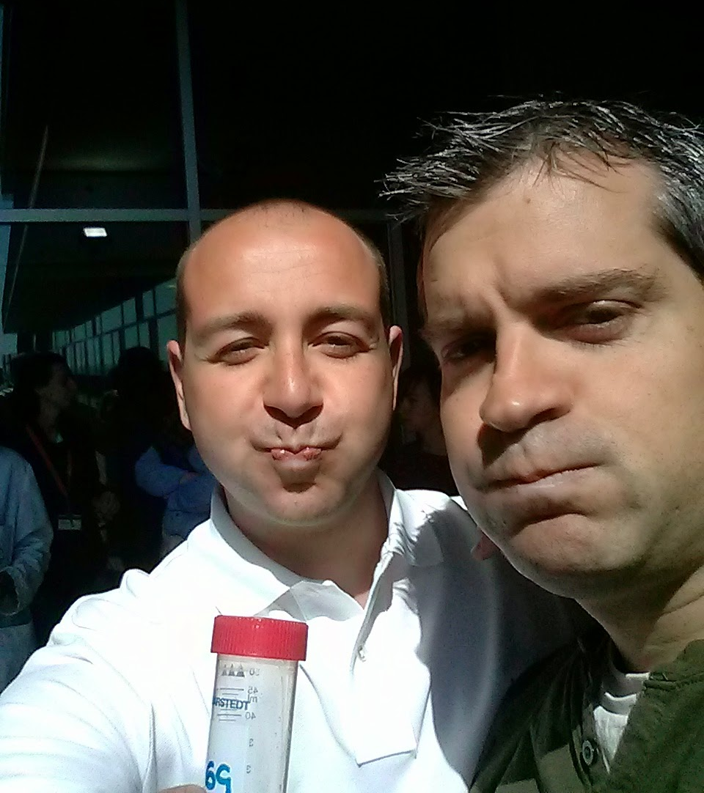
Pilot study (CRG people)
Data
187 samples
46.756.400 sequences
14.073.676.400 nucleotides
30 Gb
Aim
Testing pipelines
Comparison with published data

Slide 38
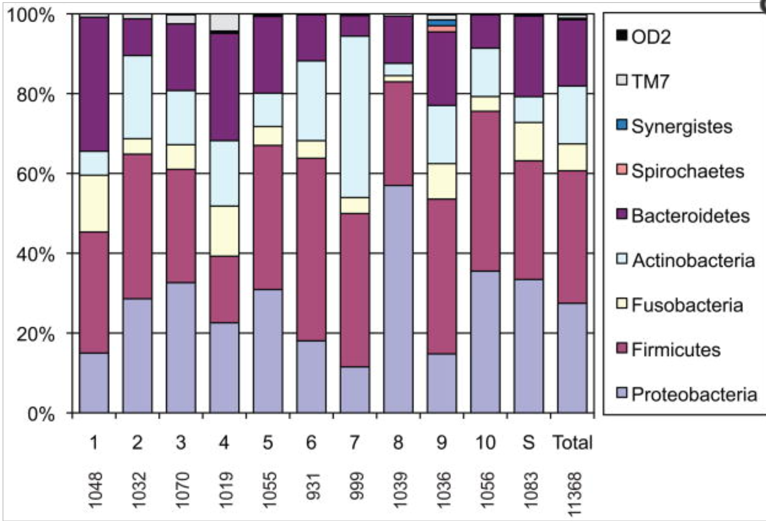
Taxonomy level 2 (Phylum)
10 random samples from 187 tests
Oral communities from 10 healthy individuals
Bik et al., ISME J. 2010 Aug; 4(8): 962–974)

Slide 39
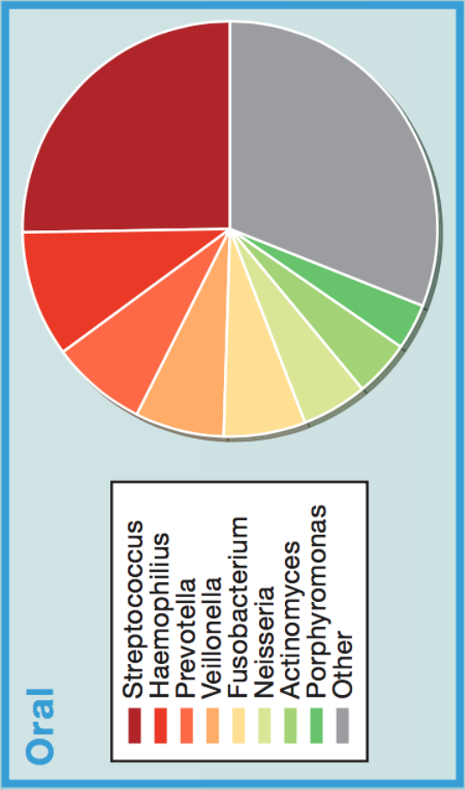
Relative bacteria abundances in 187 samples (Genera and Phylum)
Distribution of genera members of the oral communities from 250 healthy individuals
(Gonzales et al., Cell 2014)

Slide 40
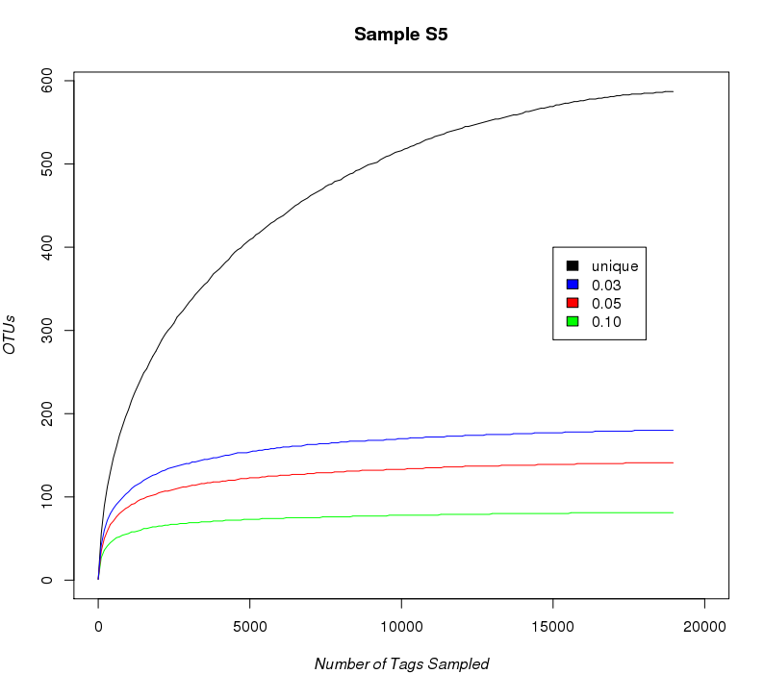
How many reads do we need per sample?
Rarefaction curves for assessing the species richness from the results of sampling (mothur, max ambiguity 4)

Slide 41

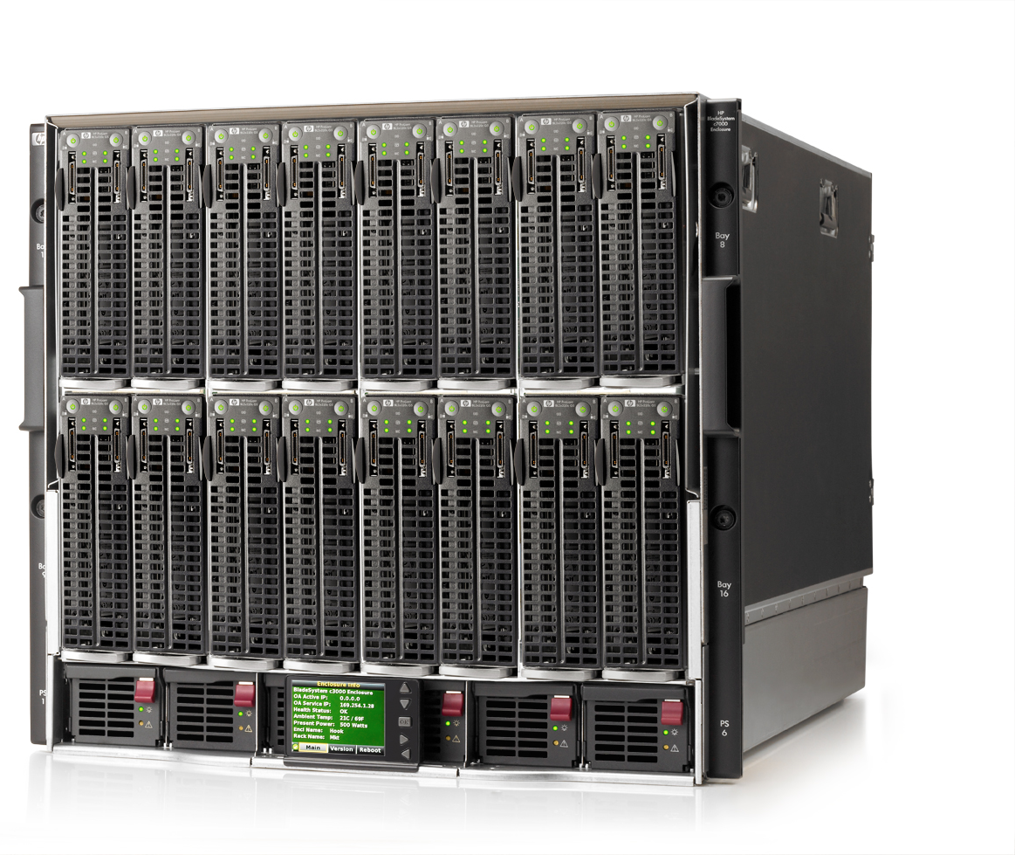
Data
1,582 samples
89,723,195 sequences
53,833,917,000 bp
121 Gigabytes
1,583,830 sequences
Computing infrustructure
80 nuclei
1,280 CPUs
From 48Gb to 512Gb of RAM
4 x 1024 TeraBytes of hdd space

Slide 42
1,502 of 1,582 collected samples were analyzed further
 | run 1 | run 2 | run 3 | run 4 | run 5 | run 6 | run 7 | run 8 | run 9 | TOT | % ORI
num samples | 190 | 192 | 190 | 192 | 192 | 192 | 190 | 190 | 54 | 1,582 | 100.0
samples >=10K | 177 | 188 | 188 | 188 | 188 | 185 | 184 | 178 | 53 | 1,529 | 96.6
samples >=20K | 175 | 188 | 188 | 188 | 188 | 185 | 183 | 178 | 53 | 1,526 | 96.5
samples >=30K | 174 | 188 | 188 | 188 | 188 | 185 | 180 | 178 | 53 | 1,522 | 96.2
samples >=40K | 174 | 188 | 187 | 186 | 187 | 185 | 164 | 178 | 53 | 1,502 | 94.9
samples >=50K | 174 | 186 | 185 | 184 | 185 | 180 | 135 | 171 | 53 | 1,453 | 91.8

Slide 43
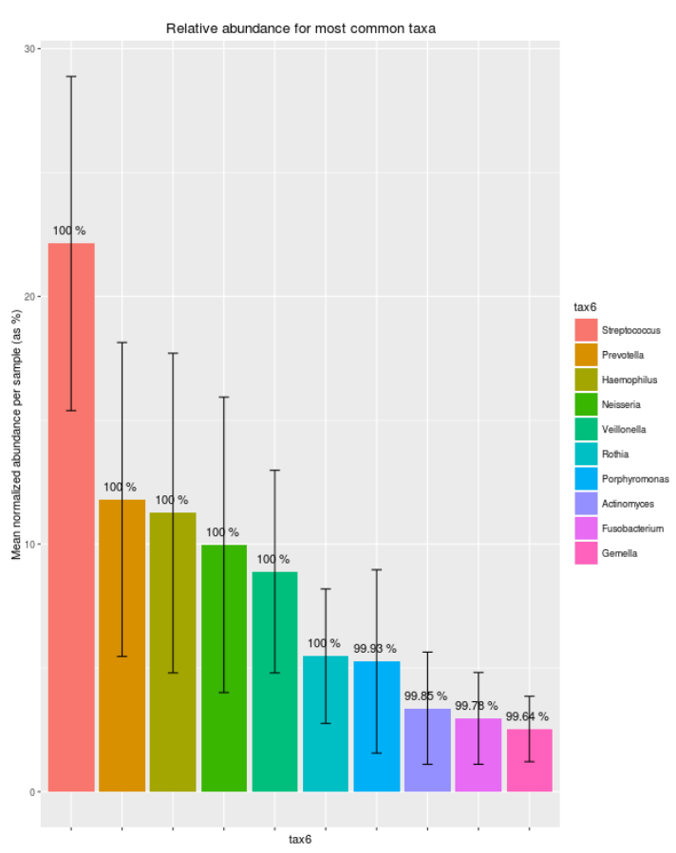
Relative abundance of most common genera
Distribution of genera members of the oral communities from 250 healthy individuals
(Gonzales et al., Cell 2014)

Slide 44
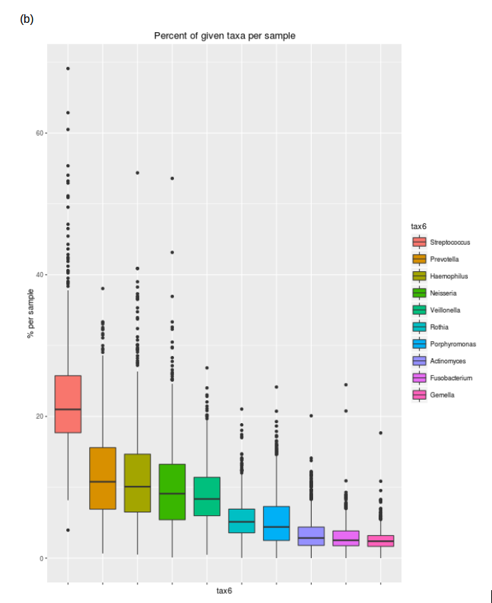
Streptococcus genus was present in 100% of the samples at an average relative abundance of 22% (range 4% - 69%) and was the most abundant genera in 68% of the samples

Slide 45
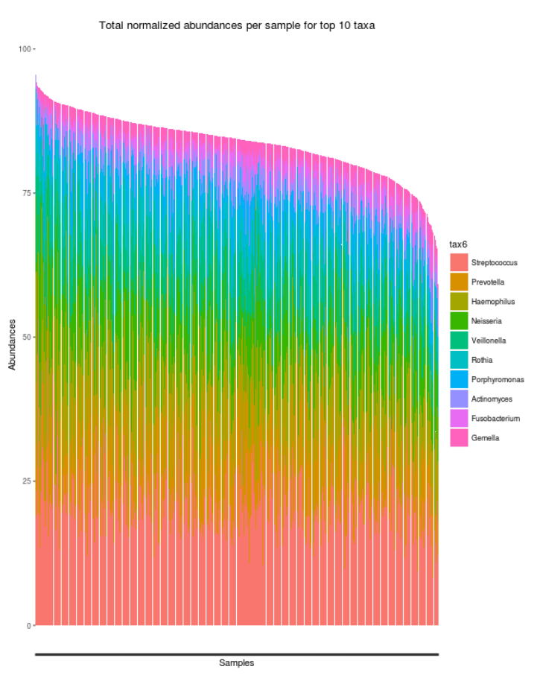
Distribution of the top 10 abundant genera across the 1502 samples

Slide 46
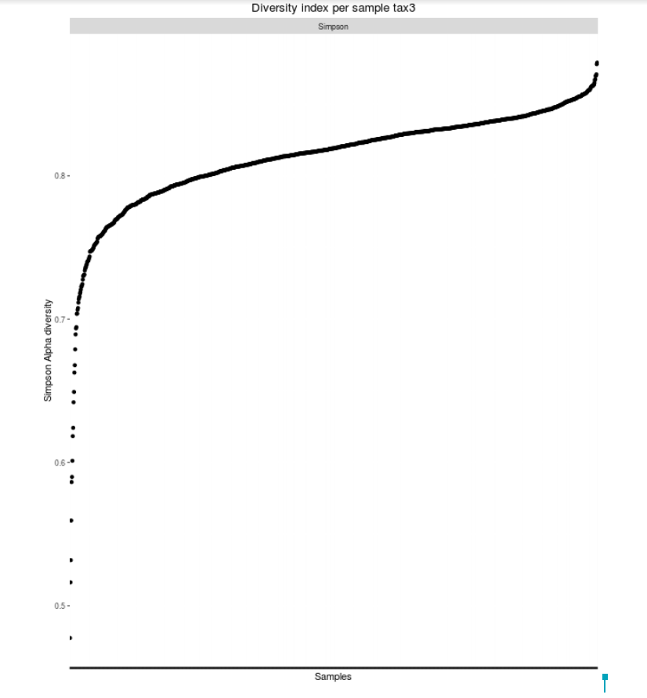
Alpha-diversity in 1502 samples: How many different species in each individual sample

Slide 47
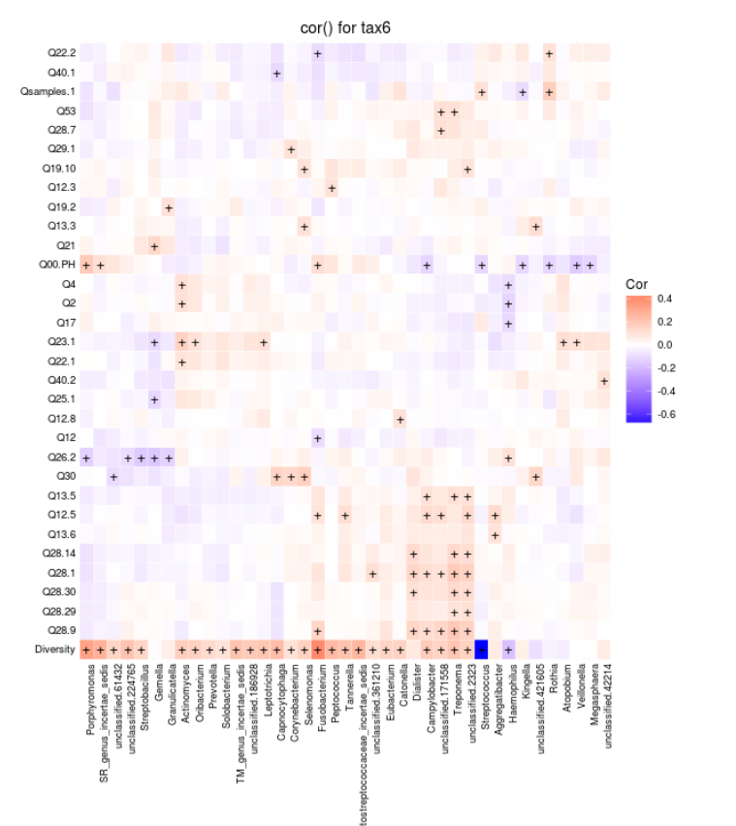
Correlation of bacterial genera with answers to questions (categorical and continuous variables) in 1502 samples

Slide 48
Granulicatella correlated with having dogs at home
Dogs

Slide 49
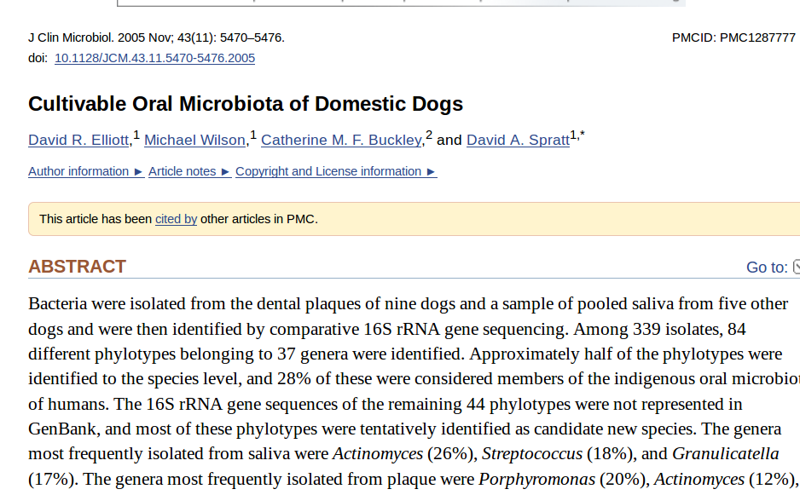
Granulicatella was shown to be the 3rd most abundant genus in dog's saliva

Slide 50
Porphyromonas correlated with increased pH in the mouth
pH

Slide 51
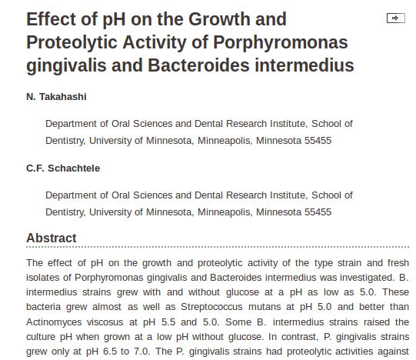
Porphyromonas correlation with pH is consistent with physiology of this bacteria

Slide 52
Salty snacks

Slide 53
Drinks (Coke, Redbull, ..)

Slide 54
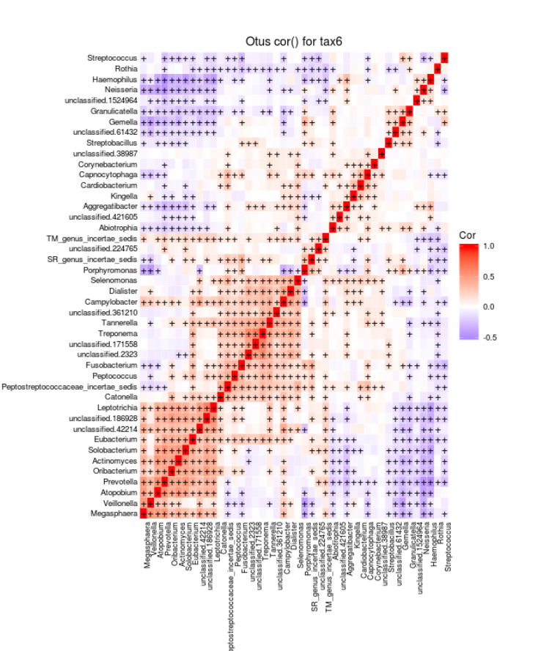
Very high correlations between some taxa: Do they form communities?

Slide 55
Acknowledgments
Luis Serrano (CRG Director)
Toni Gabaldon (CRG PI) and his group members
Monica Morales (Head of CRG core facilities)
CRG Bioinformatics Unit:
  Luca Cozzuto
  Carlos Company
  Sarah Bonnin
  Toni Hermoso
  David Harris Onywera (U. Cape Town, South Africa; 6-months intern on the CRG-Novartis-Africa Mobility Program)
CRG Genomics Unit:
  Jochen Hecht
  Nuria Andreu Somavilla
  Anna Ferrer
CRG Biomolecular Screening & Protein Technologies Unit:
  Carlo Carolis
  Miriam Alloza
CRG Communication Department:
  Gloria Lligadas
  Annick Labeeuw
The “Saca la Lengua” project is an initiative of CRG and the “la Caixa” Foundation, with the participation of the Center for Research into Environmental Epidemiology (CREAL), and the “Center d’Excellència Severo Ochoa 2013-2017” programme (SEV-2012-02-08) of the Ministry of Economy and Competitiveness.

