Slide 1

Unix/Linux for beginners:
A brief introduction to UNIX history and the most useful commands.
Ernesto Lowy & Toni Hermoso Pulido
Bioinformatics Core facility

Slide 2
UNIX
UNIX is a computer operating system originally developed in 1969 by a group of AT&T employees at Bell Labs
In constant development since its creation
Intimately related to the C programming language
There are different types of Unix (sharing some characteristics), the most popular are:
Sun/Solaris
Gnu/Linux
MacOS X
Notes:
AT&T Corp., originally American Telephone and Telegraph Company, is an American telecommunications company that provides voice, video, data, and Internet telecommunications and professional services to businesses, consumers, and government agencies. During its long history, AT&T was at times the world's largest telephone company, the world's largest cable television operator, and a regulated monopoly. At its peak in the 1950s and 1960s, it employed one million people and its revenue was roughly $300 billion annually in 2006 dollars.
Bell Laboratories operates its headquarters at Murray Hill, New Jersey, and has research and development facilities throughout the world. Researchers working at Bell Labs are credited with the development of radio astronomy, the transistor, the laser, the charge-coupled device (CCD), information theory, the UNIX operating system, the C programming language and the C++ programming language. Seven Nobel Prizes have been awarded for work completed at Bell Laboratories.

Slide 3
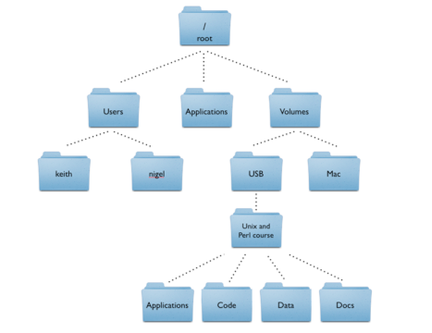
UNIX Philosophy
Portable
Same code should work the same in different platforms
Multi-tasking
Different processes can run simultaneously
Every process has a unique identifier (PID)
Multi-user
Many people can use the same machine at the same time
Users can share resources and processes
Hierarchical file system
Notes:
Unix portability: Unix was the first production operating system to be ported between differing processor families (Version 6 Unix, 1976-77). Today, Unix is routinely ported to every new machine powerful enough to sport a memory-management unit. Unix applications are routinely moved between Unixes running on wildly differing hardware; in fact, it is unheard of for a port to fail.
Portability has always been one of Unix's principal advantages. Unix programmers tend to write on the assumption that hardware is evanescent and only the Unix API is stable, making as few assumptions as possible about machine specifics such as word length, endianness or memory architecture. In fact, code that is hardware-dependent in any way that goes beyond the abstract machine model of C is considered bad form in Unix circles, and only really tolerated in very special cases like operating system kernels.
Hierarchical file system: A file system that organizes data and program files in a top-to-bottom structure. All modern operating systems use hierarchical file systems, wherein access to the data starts at the top and proceeds downward throughout the levels of the hierarchy.
Root directory: In hierarchical file systems, the starting point in the hierarchy.

Slide 4

GNU (GNU is not UNIX)
Principle
Project started in 1983 by Richard M. Stallman after a dramatic experience with a printer in the MIT
UNIX implementation based uniquely on free software
Free software means: users have the freedom to run, copy,
distribute, study, change and improve the software
Outcome
Most basic tools are from GNU project
However, a kernel (core of the OS) was missing
Notes:
GNU was launched by Richard Stallman (rms) in 1983, as an operating system which would be put together by people working together for the freedom of all software users to control their computing.
The primary and continuing goal of GNU is to offer a Unix-compatible system that would be 100% free software. GNU packages include user-oriented applications, utilities, tools, libraries, even games—all the programs that an operating system can usefully offer to its users. Linux is the kernel: the program in the system that allocates the machine's resources to the other programs that you run. The kernel is an essential part of an operating system, but useless by itself; it can only function in the context of a complete operating system. Linux is normally used in combination with the GNU operating system: the whole system is basically GNU with Linux added, or GNU/Linux. All the so-called “Linux” distributions are really distributions of GNU/Linux.

Slide 5

GNU/Linux
GNU/Linux
Most popular UNIX-like operating system nowadays
Based on the Linux kernel -> developed by Linus Torvalds in 1991
Inspired on MINIX, an educational demo of UNIX
Deployed in many systems
Computers, laptops, mobiles, video game consoles,
supercomputers, etc
Many distributions or tastes
Desktop / workstation: Ubuntu, Fedora
Server: Debian, RedHat
Handset: Android, MeeGo, etc
Notes:
Linux® was born out of the desire to create a free software alternative to the commercial UNIX environments. Its history dates back to 1991, or further back to 1983, when the GNU project, whose original aims where to provide a free alternative to UNIX, was introduced. Linux runs on a much wider range of platforms than most UNIX environments, such as the Intel®/AMD led x86 platform. Most UNIX variants run on just one architecture.
Because of this history and the heritage of the two products, Linux and UNIX have a common foundation, but are also very different. Many of the tools, utilities, and free software products that are standard under Linux were originally developed as free alternatives to the versions available on UNIX. Linux often provides support for many different options and applications, picking the best (or most popular) functionality from the UNIX and free software environment.
MINIX is a Unix-like computer operating system based on a microkernel architecture created by Andrew S. Tanenbaum for educational purposes; MINIX also inspired the creation of the Linux kernel.
MINIX (from "mini-Unix") was first released in 1987, with its complete source code made available to universities for study in courses and research. It has been free and open source software since it was re-licensed under the BSD license in April 2000.

Slide 6
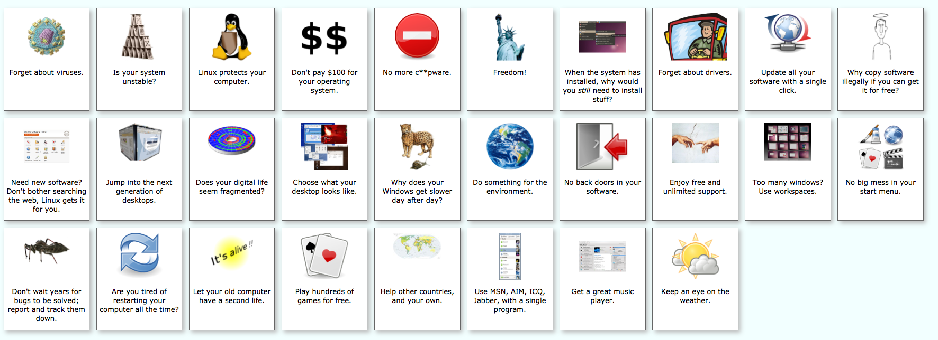
Linux advantages
http://www.whylinuxisbetter.net/

Slide 7
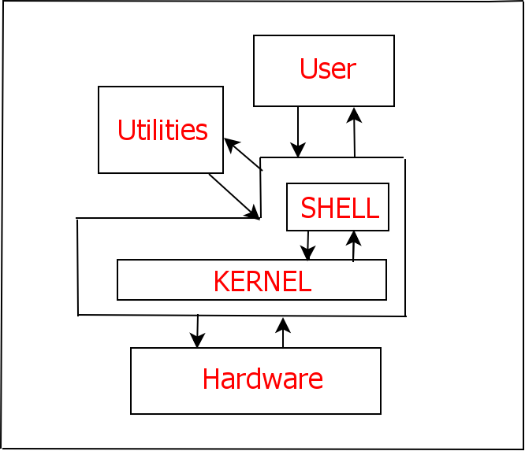
UNIX layers
The Kernel
Hub of the operating system. It allocates
resources for programs in response to system calls
The Shell
Interface between the user and the Kernel
Example:
User enters ls –al, the shell look for this program and request the Kernel (through a system call) to execute this program.
The shell notifies the user when the ls process is
finished so the user can launch another command
http://eglug.org/node/456
Notes:
The part of UNIX that manages the hardware and the executing processes is called the kernel. The kernel is a collection of programs written in C which directly communicate with the hardware. Each hardware device is viewed as a file and is called a device file. This allows the same simple method of reading and writing files to be used to access each hardware device. The file system manages read and write access to user data and to devices, such as printers, attached to the
system. It implements security controls to protect the safety and privacy of information. In executing processes the kernel allocates resources, including use of the CPU and mediates accesses to the hardware.
The user commands are translated into action by the shell which acts as an interpreter. The shell forms the outer part of the operating system and forms the interface between the user and the kernel. For each user logged in, there is shell in action. When a command is given by the user, it is examined by the shell and communicated to the kernel for execution. The functions used to communicate with the kernel are called system calls and are built into the kernel. The system calls are in all the flavors of UNIX are the same. Hence, software developed on one UNIX system can be easily run on another UNIX system.
UNIX's layered design insulates the application from the different types of hardware. This allows the software developer to support the single application on multiple hardware types with minimal effort. The application writer has lower development costs and a larger potential customer base. Users not only have more applications available, but can rely on being able to use the same applications on different computer hardwar

Slide 8
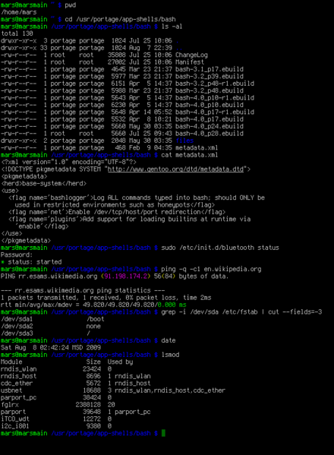
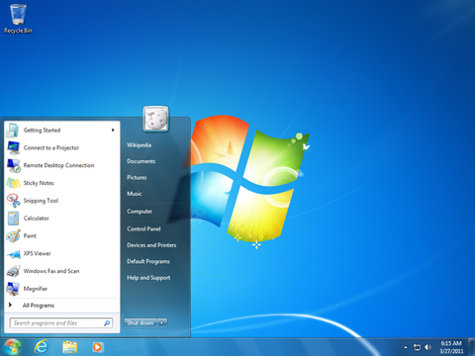
Shell (I)
Provide an interface for users of an operative system
Can be command line or graphical
CLI (Command-Line Interfaces) are used to work with UNIX machines
In CLIs the user issues commands to the programs in the form of successive lines of texts

Slide 9
Shell (II)
Advantages of using a CLI
Control | Users can copy a specific file from one location to another with a one-line command.
Speed | Command line users only need to use their keyboards to navigate a command line interface and often only need to execute a few lines to perform a task.
Resources | A computer that is only using the command line takes a lot less of the computers system resources than a GUI.
Scripting | A command line interface enables a user to script a sequence of commands to perform a task or execute a program.
Diverse | It does not change as much as the GUI. Although new commands may be introduced, the original commands always remain the same.
Strain | The command line allows the user to keep their hands on the keyboard and rarely have to move from the keyboard to the mouse. Moving back and forth between a keyboard and mouse can cause additional strain and may help contribute to RSIs (repetitive strain injury) syndrome.
http://www.computerhope.com/issues/ch000619.htm

Slide 10
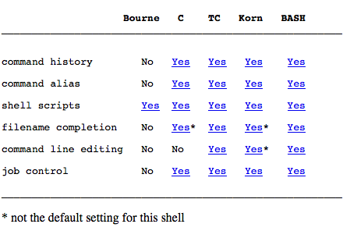
Types of shell
There are several different shells available for Unix, the most popular are:
Bourne shell (sh)
C shell (csh)
TC shell (tcsh)
Korn shell (ksh)
Bourne Again SHell (bash)
Summary of features:
original one
most popular one
http://unixhelp.ed.ac.uk/shell/oview1.1.html
Notes:
Job control: When using Unix or related operating systems via a terminal, a user will initially only have a single process running, their login shell. Most tasks (directory listing, editing files, etc.) can easily be accomplished by letting the program take control of the terminal and returning control to the shell when the program exits; however, sometimes the user will wish to carry out a task in the background while using the terminal for another purpose. Job control is a facility developed to make this possible, by allowing the user to start programs in the background, send programs into the background, bring background processes into the foreground, and start and stop running programs. Processes under the influence of a job control facility are referred to as jobs.
Command line editing: Often during an interactive session you type in a long line of text, only to notice that the first word on the line is misspelled. The Readline library gives you a set of commands for manipulating the text as you type it in, allowing you to just fix your typo, and not forcing you to retype the majority of the line. Using these editing commands, you move the cursor to the place that needs correction, and delete or insert the text of the corrections. Then, when you are satisfied with the line, you simply press RETURN. You do not have to be at the end of the line to press RETURN; the entire line is accepted regardless of the location of the cursor within the line.

Slide 11
Exercise 1
Open a terminal (a.k.a shell) and figure out what type of shell you have
Solution:
In Mac OS X:
Open Applications >> Utilities subfolder >> Terminal
or
Open Applications >> Terminal
Type echo $SHELL and hit enter and check what you get (NOTE: echo is a Unix command to print something into the screen)
Recommended terminal for Mac OS X:
http://www.iterm2.com
Notes:
Bash shell and prompt
The bash shell is actually a program that is located at /bin/bash and is executed by Linux the moment a user successfully logs in after entering his user-pass. Once this shell starts, it takes over control and accepts all further user commands. The bash shell presents a $ prompt by default (for normal user accounts). You can change this prompt to whatever you like but leaving it at the default is best. Other shells present different prompts.

Slide 12
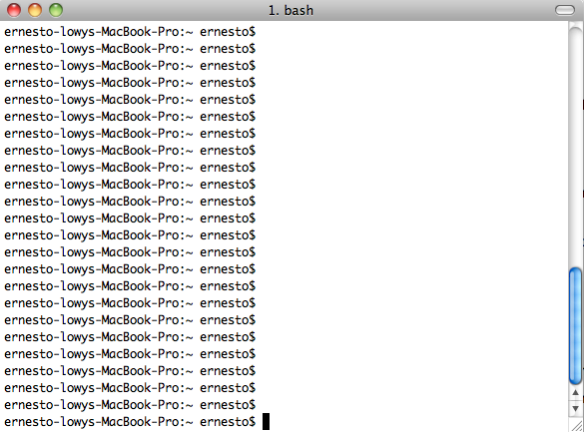
Command prompt
Prompts the user to take action
Structure:
Command prompt
computer name
user name
current dir name
Notes:
$ symbol is typical from bash shells

Slide 13
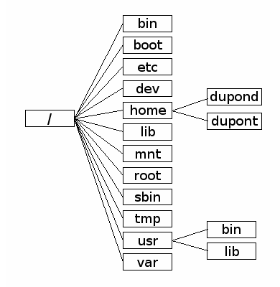
UNIX Directory tree
GNU/Linux
http://korflab.ucdavis.edu/Unix_and_Perl/
http://labor-liber.org/en/gnu-linux/introduction/all
Mac OS X
Notes:
The Unix tree
Looking at directories from within a Unix terminal can often seem confusing. But bear in mind that these directories are exactly the same type of folders that you can see if you use Apple’s graphical file-management program (known as ‘The Finder’). A tree analogy is often used when describing computer filesystems. From the root level (/) there can be one or more top level directories, though most Macs will have about a dozen. In the example below, we show just three. When you log in to a computer you are working with your files in your home directory, and this will nearly always be inside a ‘Users’ directory. On many computers there will be multiple users.
All Macs have an applications directory where all the GUI (graphical user interface) programs are kept (e.g. iTunes, Microsoft Word, Terminal). Another directory that will be on all Macs is the Volumes directory. In addition to any attached external drives, the Volumes directory should also contain directories for every internal hard drive (of which there should be at least one, in this case it’s simply called ‘Mac’). It will help to think of this tree when we come to copying and moving files. E.g. if we had a file in the ‘Code’ directory and wanted to copy it to the ‘keith’ directory, we would have to go up four levels to the root level, and then down two levels.

Slide 14
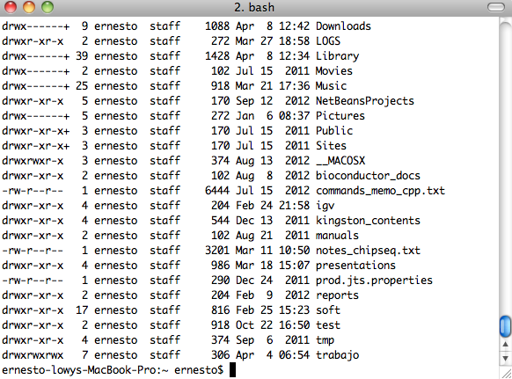
Simple commands (I)
ls (list the contents of a folder)
Enter ls (what do you see?)
Enter ls –l (what do you see?)
Notes:
ls –l: list in long formatd (this is a directory)
rwx------ (access permissions)
2 (number of links)
erpl08 (owner)
iss (group ownership)
1024 (size in bytes)
Jun 17 10:00 (date and time last modified)

Slide 15
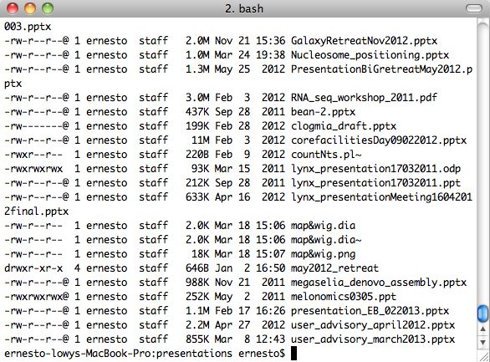
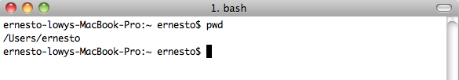
Simple commands (II)
ls –lh (use unit suffixes)
pwd (where am I)
When a terminal is opened we are placed into our home folder

Slide 16
Simple commands (III)
cd (Change Directory)
Move into the Desktop/ folder
Change into the Desktop folder (try the autocompletion resource)
$ cd /Users/ernesto/Desktop
Check that you are there
$ pwd
See what are the contents of the Desktop folder
$ ls
The . (dot) is the symbol used to represent the current working directory
$ ls .
Go ‘upwards’ one level so we reach the home folder
$ cd /Users/ernesto/
or
$ cd ../
Check that you are there
$ pwd
Move around your file system and then
Come back home
$ cd

Slide 17

Simple commands (IV)
List the files one level up in the file hierarchy
$ cd
$ ls ../
mkdir (create a directory)
Go home
$ cd
Create a directory named ‘Course’ (Case matters!)
$ mkdir Course
$ cd Course
$ pwd
Create a subdirectory named ‘subCourse’
$ mkdir subCourse
$ cd subCourse
rmdir (delete one directory)
$ rmdir subCourse
$ ls

Slide 18
Simple commands (V)
touch (create an empty file)
$ cd
$ touch example1.txt
$ touch example2.txt
$ ls
mv (move one file from one point to another)
$ mv example1.txt Course/
$ mv example2.txt Course/
mv (rename a file)
$ cd Course
$ mv example1.txt example3.txt
rm (delete a file) Most dangerous command!!!
$ rm example3.txt

Slide 19
Simple commands (VI)
cp (copy files)
Copy example1.txt one level up into the file hierarchy
$ cp example1.txt ../
Create an identical copy of example1.txt named example2.txt
$ cp example1.txt example2.txt
man (getting help)
$ man ls
$ man cp
Once within man you can:
Scroll down by pressing space
Go back by pressing b
Quit by pressing q

Slide 20
The * wildcard
Most used wildcard
Used in combination with a lot of Unix commands (ls,cp, etc.)
Matches any character 0 or more times
Exercise 2:
Go to Course directory and create a directory named ex2, go to ex2
Create three different files with touch named: file1.txt, file2.txt, file3.txt
List all of them using the * wildcard
Copy all one level up the using the * wildcard

Slide 21
Networking from the terminal
Download a file from an URL
$ cd
$ cd Course/
$ wget http://nin.crg.es/bioinfo/unix_course/Saccharomyces_cerevisiae.EF4.70.gtf
$ curl http://nin.crg.es/bioinfo/unix_course/ Saccharomyces_cerevisiae.EF4.70.gtf > Saccharomyces_cerevisiae.EF4.70.gtf
‘>’ greater than symbol is used for output redirection
Example:
$ cd
$ ls > output.txt

Slide 22
Reading the contents of a file (I)
cat command
$ cd
$ cd Course/
show the contents of the file
$ cat Saccharomyces_cerevisiae.EF4.70.gtf
use output redirection to create a copy
$ cat Saccharomyces_cerevisiae.EF4.70.gtf > copy.gtf
concatenate Saccharomyces_cerevisiae.EF4.70.gtf and copy.gtf
$ cat Saccharomyces_cerevisiae.EF4.70.gtf copy.gtf > new.gtf

Slide 23
wc command
wc command (displays number of lines, words, and bytes)
$ wc Saccharomyces_cerevisiae.EF4.70.gtf
Show only the number of lines
wc –l Saccharomyces_cerevisiae.EF4.70.gtf
Check number of lines of Saccharomyces_cerevisiae.EF4.70.gtf copy.gtf and new.gtf
wc –l Saccharomyces_cerevisiae.EF4.70.gtf copy.gtf and new.gtf
wc –l *.gtf

Slide 24
Reading the contents of a file (II)
less command is similar to cat but more advanced
$ less Saccharomyces_cerevisiae.EF4.70.gtf
less –N (print the line numbers)
$ less –N Saccharomyces_cerevisiae.EF4.70.gtf
press enter to scroll down line by line
press space to scroll down one window
press b to scroll backwards one window
type /YBR156C to look for this gene_id in the text

Slide 25
Pipes
Pipes (|) it is used to execute processes concurrently that pass data from one to the other
Get number of files in the home folder
$ cd
$ ls | wc –l
Exercise 3 Remove duplicated ensembl ids from a file:
$ cd Course
download file from our server
$ curl http://nin.crg.es/bioinfo/unix_course/ensembl_ids.txt > ensembl_ids.txt
use cat, sort and uniq commands to remove duplicated entries
$ cat ensembl_ids.txt |sort |uniq

